Slide 1
What’s New in SAFe® 5?
Evolving the Scaled Agile Framework

Slide 2
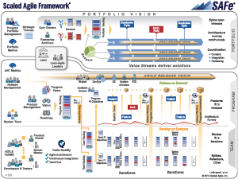
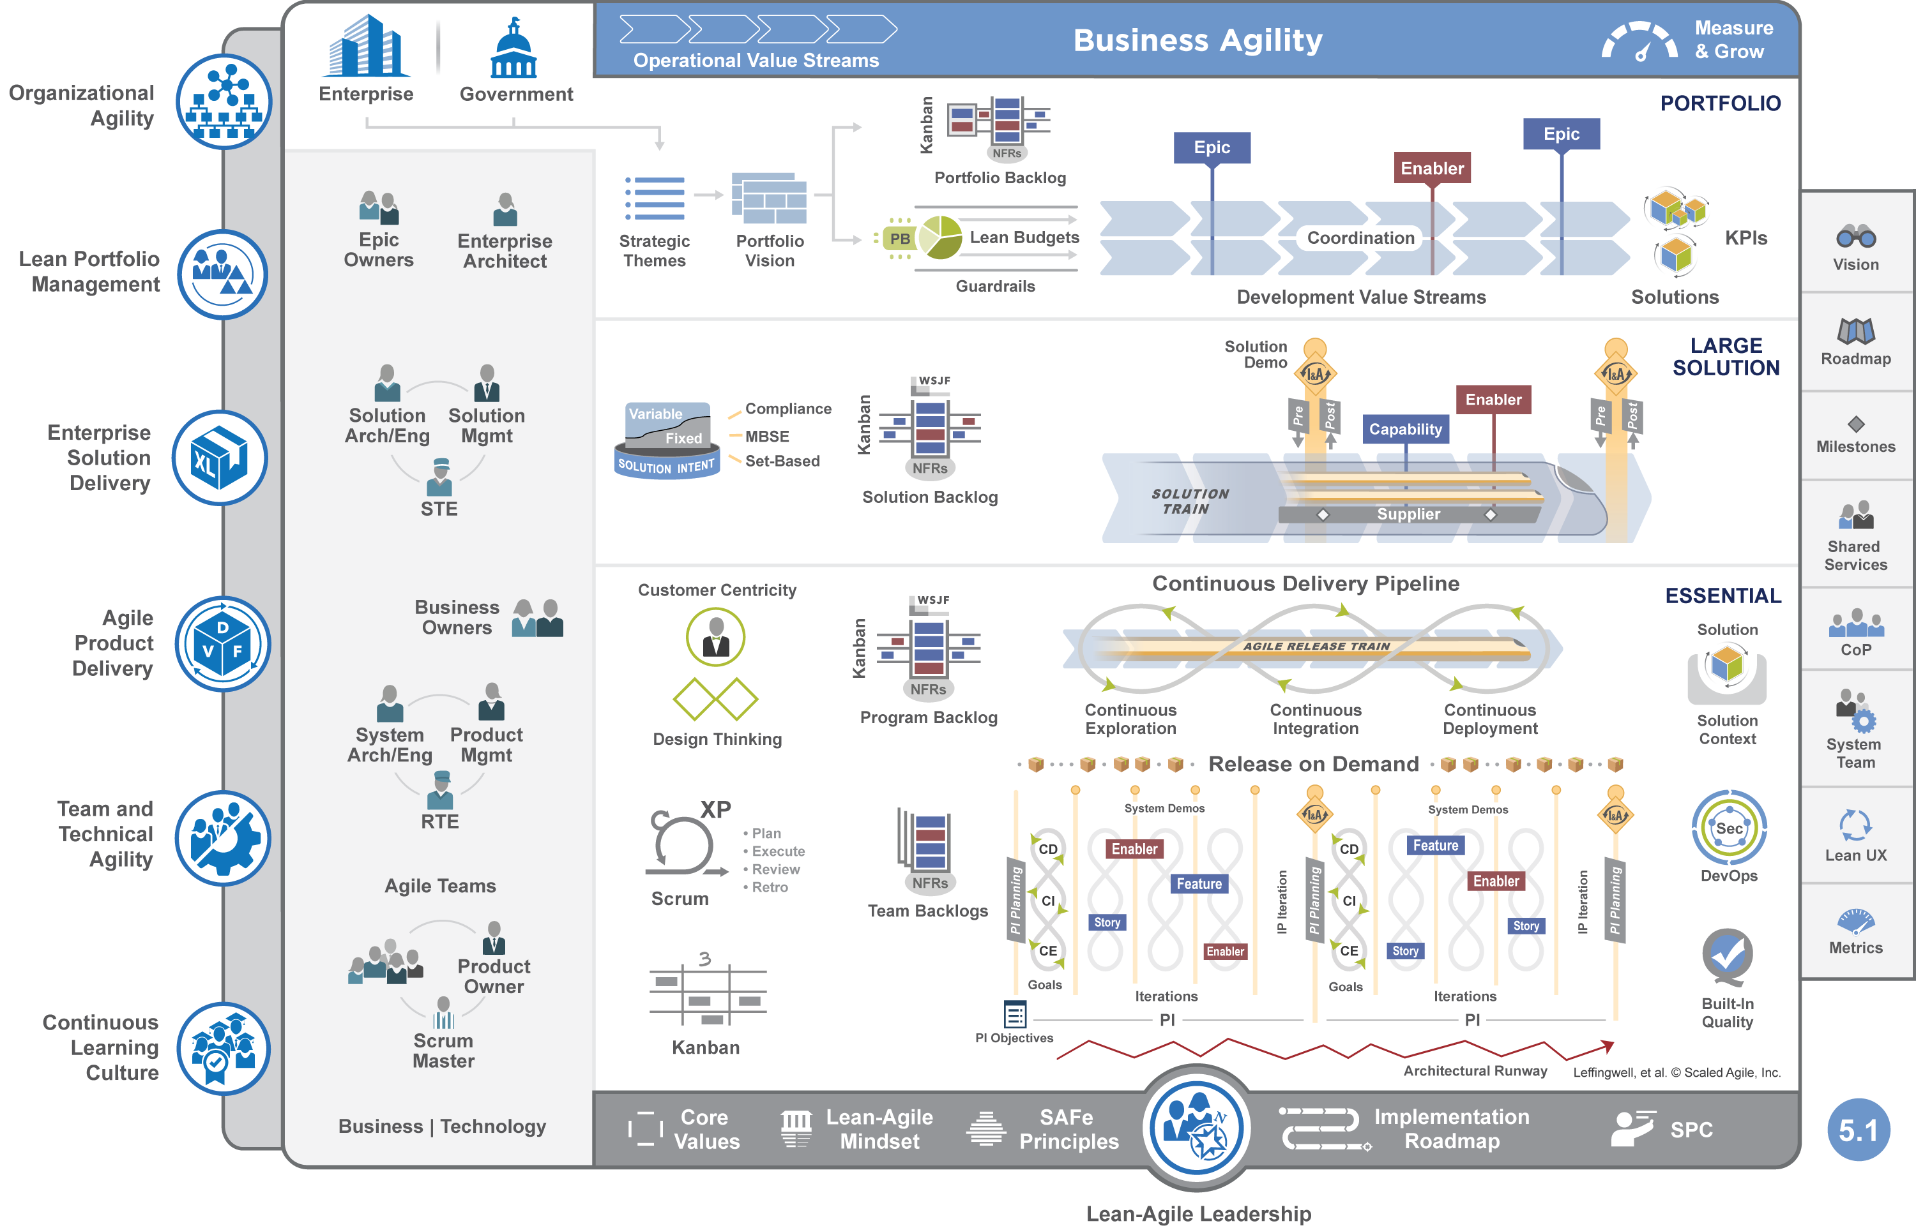
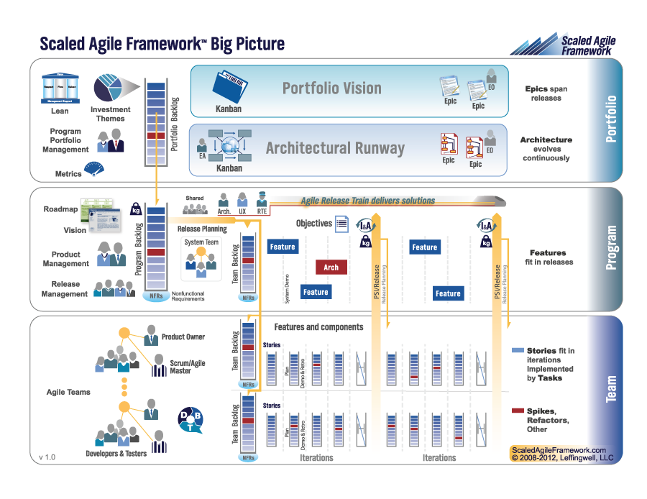
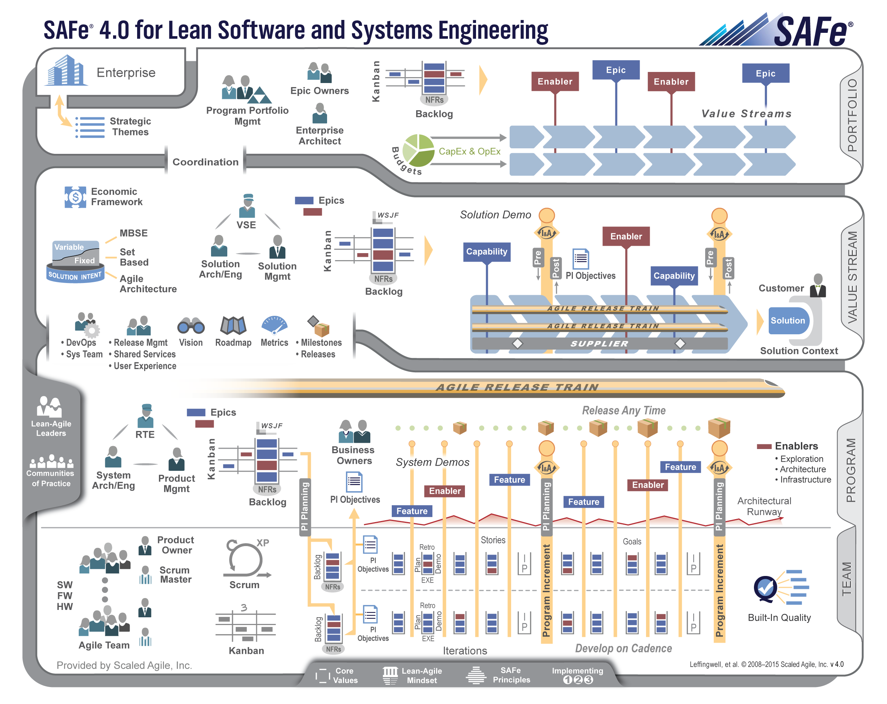
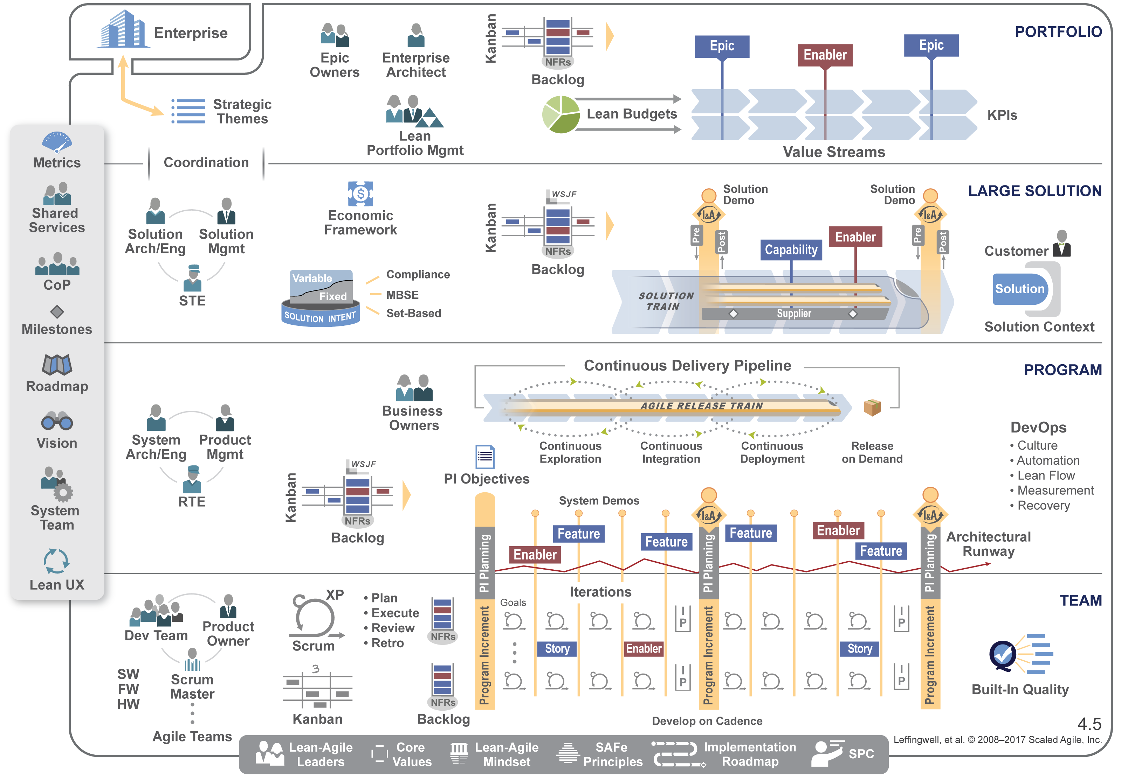
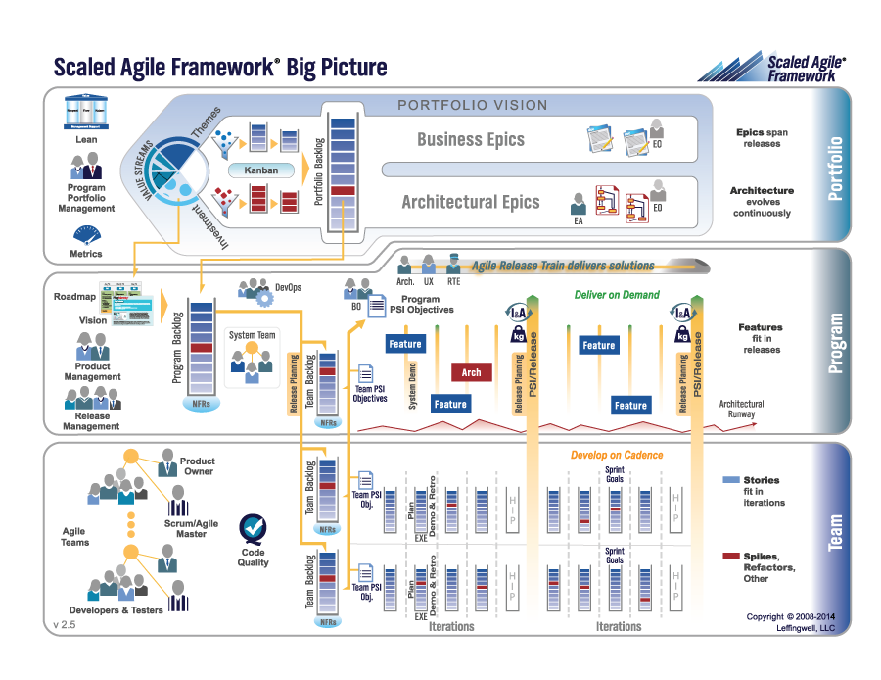
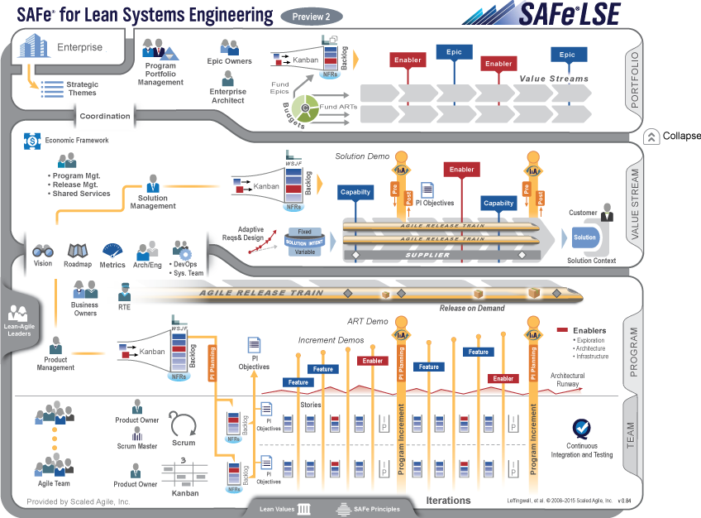
SAFe: Roots, past, present, and future
2011
Field experience at Enterprise scale
Now…
SAFe 1.0
SAFe 3.0
SAFe 4.0
SAFe 2.0
LSE
SAFe 4.5
SAFe 4.6
SAFe 5
Lean product development | Agile development | DevOps | Systems thinking
Notes:
Trainer Guidance:
And you will have seen us go from one version of the framework to the next as shown on this slide. This set of updates for not constitute a new version of the framework. What we are presenting is a set of updates to the SAFe 5 as part of our continued support and evolution of the Framework.

Slide 3
SAFe® 5 for Lean Enterprises is the world’s leading framework for business agility. SAFe integrates the power of Lean, Agile, and DevOps into a comprehensive system that helps enterprises thrive in the digital age by delivering innovative products and services faster, more predictably, and with higher quality.
3
Notes:
Trainer Guidance:
When we launched this current version of the framework back in January it was launched as SAFe 5.0. Today we are simplifying this message and referring to it as SAFe 5.
Simply put, this latest version of the SAFe Framework and the collected body of knowledge that it represents is known as SAFe 5 for Lean Enterprises.
And we commit to continuing to update SAFe 5 through new articles, improvements to existing articles, and from time to time, updates to the BP which is the method we use to visualise the framework the roles, activities and practices in the framework.
And the set of SAFe 5 updates that I want to share with you today does indeed include some updates to the Big Picture.
The Big Picture therefore, will be updated to 5.1, shown by the version number in the bottom right of the Big Picture itself, and at some point in the future it will likely update to 5.2, 5.3 etc. But always in support of SAFe 5.

Slide 4
SAFe Big Picture 5.1

Slide 5
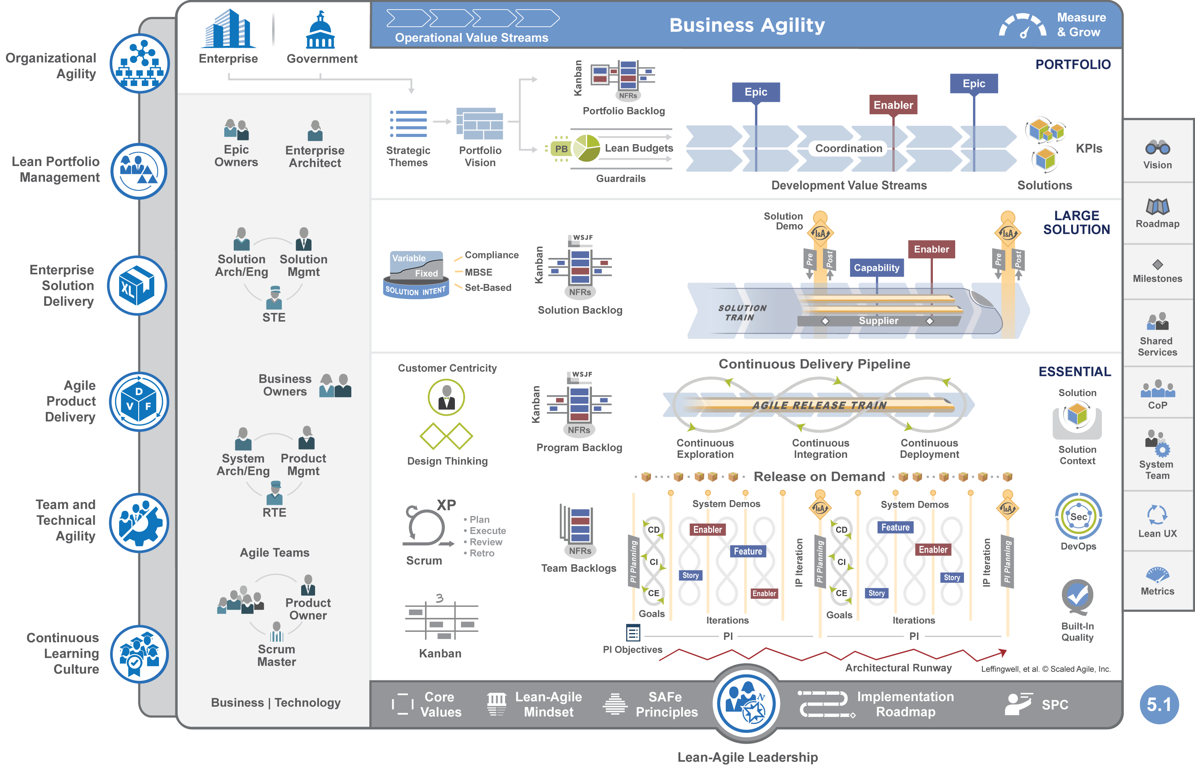
Notes:
Trainer Guidance:
And here is it. The 5.1 Big Picture.
Immediately this should look very similar to the previous BP. That’s by design. The changes have been done carefully so as not to be inconsistent with anything on the previous 5.0 Big Picture and certainly not to invalidate any of the learning or even the practices that SAFe Enterprises have in place currently.

Slide 6
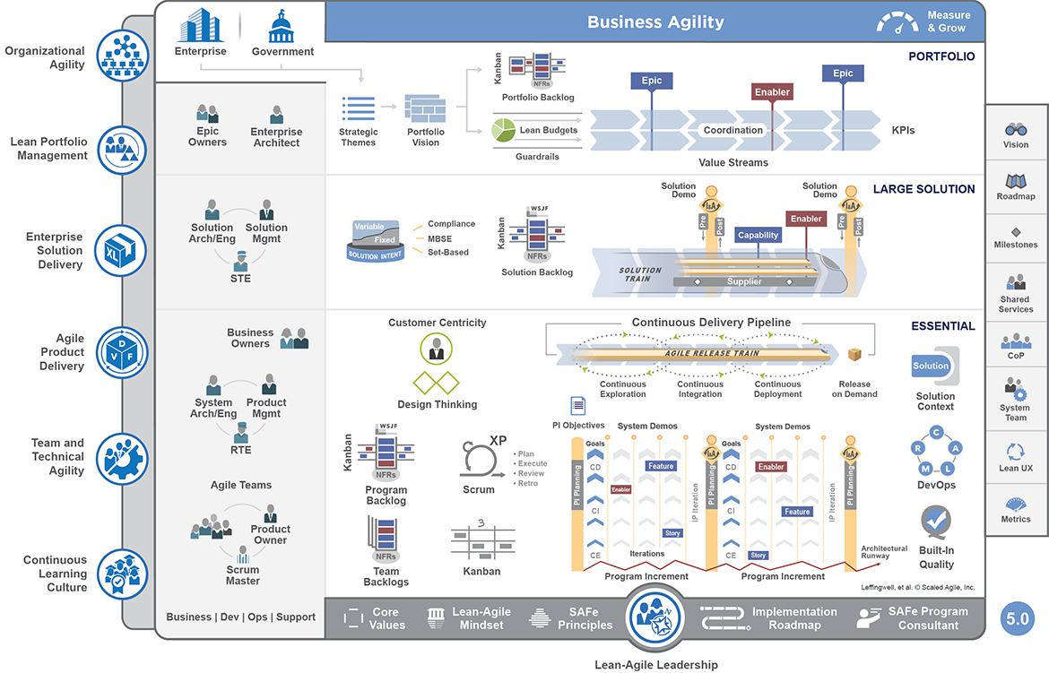
Value Streams
New Operational Value Streams icon
Renamed Development Value Streams
6
Notes:
Trainer Guidance:
We know that Value Streams are critical in SAFe. Indeed organizing around value is SAFe Principle 10 – its at the heart of what we do.
In the previous Big picture, shown at the top of this slide we have a single article ‘value streams’. You can see this highlighted in yellow. This article provides a fairly high level view of value stream, their purpose and the two types – Operational, the steps, systems and people that deliver value to the customers and Development Value Streams which identify the activities and people that develop the solutions that the Operational Values Streams use or sell.
Currently this single article provides limited practical guidance around actually identifying and organizing these values steams – something we have heard from our customers is their number one challenge.
In the 5.1 Big Picture we have introduced two separate icons. One for operational value streams, at the top of the 5.1 Big Picture and one for Development Value Streams
Later in this presentation we will look at the content behind these.

Slide 7
Portfolio Level
Solution boxes at the end of the Development Value Streams
Participatory Budgeting added to Lean Budgets
7
Notes:
Trainer Guidance:
The next set of updates are also at the Portfolio Level.
First, a clarification. A SAFe portfolio as we know governs a set of Development Value Streams. But what to Development Value Streams deliver? They deliver solutions. To make this clear we have added the solution box on the right of those Development Value Streams – this helps to remove any misunderstanding of what it is that the Development Value Streams deliver. Of course the definition of a solution is broad. A solution could be a product, a service, a system.
We have also added the Participatory Budgeting icon to the side of the Lean Budgets icon. Participatory Budgeting is our recommended approach to reconcile a set of possible investments and allocate the necessary budget to the Development Value Streams for the next budgeting period. We released a Participatory Budgeting advanced topic article last year but this addition of the PB icon will allow us to add this guidance directly on the Big Picture.

Slide 8
DevOps &
Continuous
Delivery Pipeline
Improved Continuous Delivery Pipeline (CDP) visualization
Release boxes positioned throughout the PI
CDP ‘infinity loops’ repeated in the iterations
8
Notes:
Trainer Guidance:
Moving the focus to the Essential level and some improvements to the Continuous Delivery Pipeline and DevOps.
The Continuous Delivery Pipeline, CDP, graphic has been updated to better fit with the infinity loops that are quickly becoming recognizable within the DevOps community. Of course in SAFe we have the triple infinity loops, to emphasise that we also include Continuous Exploration in our CDP. These loops are repeated in the iterations as well to emphasize that all these activities are happening each iteration.
You will also notice that the release boxes are now shown as occurring throughout the PI as well. We know that we can release on demand at any time, but this change emphasizes that point. In the previous version the release box occurred in a single place, at the end of the CDP.
Finally, and one thing we will come back to later in the presentation is the new DevOps Icons. This iconography now includes Security within it and will link to a dedicated DevOps landing page providing further links to CALMR which describes the mindset and culture, and remains at the heat of DevOps in SAFe, and a brand new page focusing on the practice domains describing the required technical practices and tools.

Slide 9
Teams and the work
Extended guidance for Business | Technology
Replaced the current Solution icon with the Design Thinking representation
9
Notes:
Trainer Guidance:
Staying at the Essential level, another update is to replace the blue solution icon and with the ‘solution box’ icon which is currently used in the APM Core Competency article, the Design Thinking article and the Agile Product Management course.
This means that we now have a consistent treatment of solution across the framework. This iconography also brings with it the key aspects of desirability. feasibility, viability and sustainability to the forefront.
In the bottom left of the BP, currently the terms ‘Business Dev Ops and Support link to the Agile Teams article, rather than a separate page.
The change in the 5.1 Big Picture is to first simplify this terminology to Business and Technology.
Second, this will be turned into a dedicated landed page covering specific Agile guidance for a multitude of different business and technical domains.
This will become an area where we can link off to guidance such as Agile marketing, Agile HR etc as well as technology domains like SAFe for Hardware.

Slide 10
Diminishing the
‘Program’ term
Abbreviated SAFe Program Consultant as SPC
Abbreviate Program Increment as PI
De-emphasize the PI boundary to avoid misinterpretation
10
Notes:
Trainer Guidance:
Finally, we have also started a piece of work to dimmish the importance of the term ‘program’ from the Big Picture.
Why? Because we no longer have a Program Level, and the term program tends to represent a more traditional way of working. Program management in contrast to product management.
First we have abbreviated SAFe Program Consultant as SPC. We have also abbreviated program increment to PI and also reduced the thickness of the PI boundaries. This also helps to emphasise that the PI is really nothing more than a planning interval and that we are delivering increments of value throughout the PI and also helps to dispel any misunderstandings that we are doing big batch delivery once a PI.

Slide 11
Significant Article Updates

Slide 12

Operational Value Stream types
Attract customer
Quick
rate
quote
Complete loan application
Eligibility decision and underwriting
Extend loan terms
Award loan
Setup payment terms
Repay money
Close loan
Loan need
Fulfillment operational Value Stream for a consumer loan
Loan repayment with interest
Procure materials
Manage inventory
Manufacture subassemblies
Assemble final product
Validate
product
Package
and ship
Order received
Manufacturing operational Value Stream for a vehicle
Vehicle
Create interest
Sales cycle
Contracts and licensing
Provisioning
Customer care
Renewals
Order received
Software product operational Value Stream
Software product
Prep financials
Engage auditors
Conduct the audit
Address issues
Revise financials
Audit
letter
Board
signoff
Annual audit requirement
Supporting operational Value Stream for annual audit
Audited financials
Notes:
Trainer Guidance:
First, we will review the new content from those Operational and Development Value Streams articles
Starting with the Operational Value Stream article. Identifying Operational Value Streams helps us understand and improve the interaction points with the customer and provides those working in the Development Value Streams with insights on how the solutions they are developing are being used.
Although we have had examples of Operational Value Streams in the past they have not always provided examples that mirror the variety that exists across SAFe Enterprises..
Therefore, we are extending the guidance to introduce ‘types’ of Operational Value Streams to provide additional clarity. This is what is covered in detail in the Operational Value Streams article.
Fulfillment for digitally-enabled products and services value streams represent the steps necessary to process a customer request, deliver a product or service, and receive remuneration. Examples include providing a consumer with an insurance product or fulfilling an ecommerce sales order.
Manufacturing value streams convert raw materials into the products customers purchase. Examples include consumer products, medical devices, and complex cyber-physical systems.
Software product value streams offer and support software products. Examples include ERP systems, SaaS, desktop and mobile applications.
Supporting value streams includes end-to-end workflows for various supporting activities. Examples include the lifecycle for employee hiring and retention, executing the annual budget process, and completing a full enterprise sales cycle
This richer, complete topology will be a great help to those organizations going through the process of identifying their operational value streams and visualizing their customer journey as the first step in considering the best way to organize their arts.

Slide 13
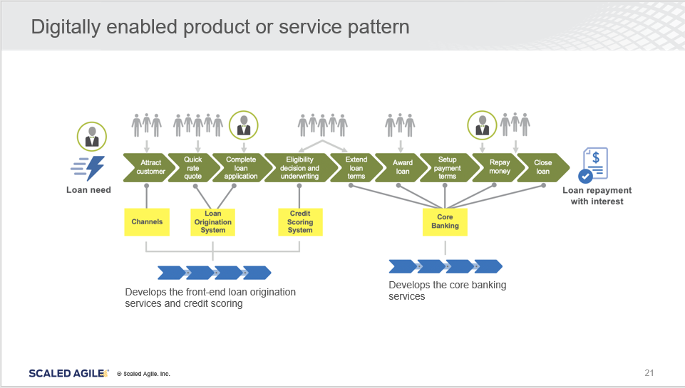
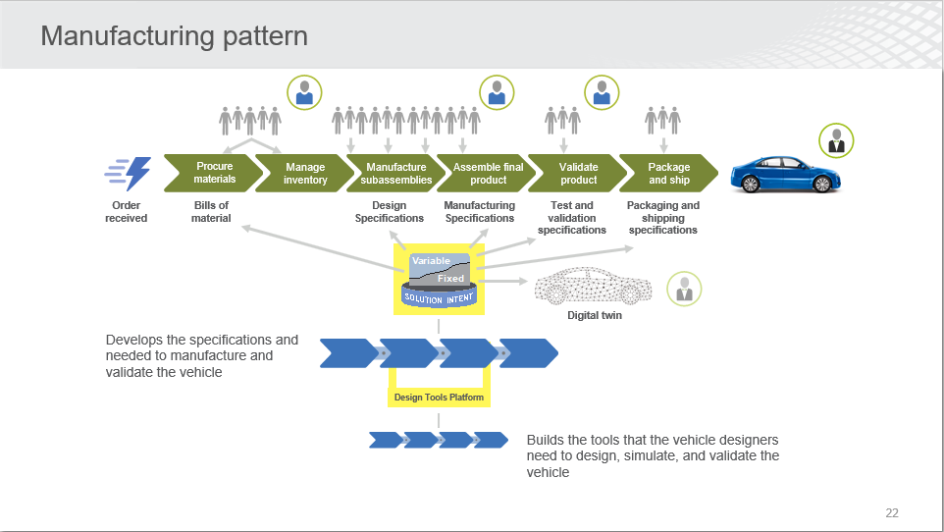
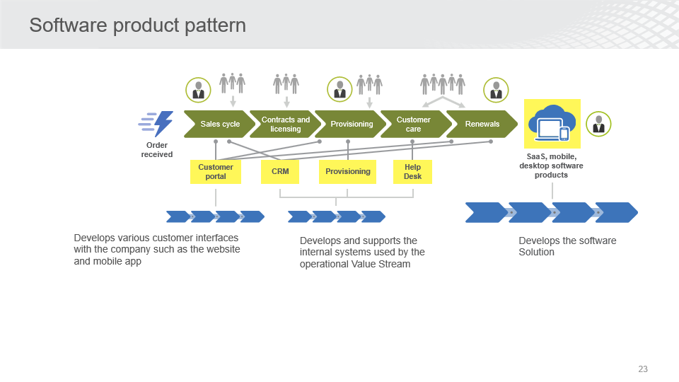
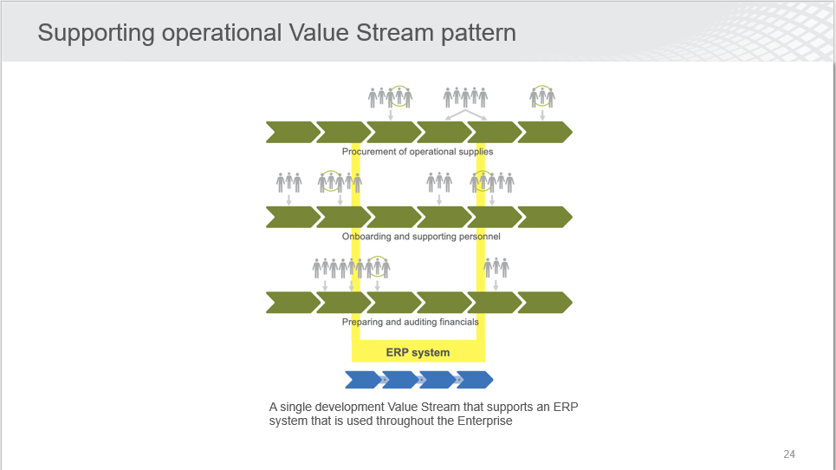
Development Value Streams patterns
Notes:
Trainer Guidance:
The next step, once we have identified Operational Value Streams is to identify Development Value Streams
These are the people and activities required to build the solutions the Operational Value Stream uses and sells.
It is critical that we organize them around the flow of value to improve workflow and reduce the time to market.
Buts its not a trivial task to organize solution builders into Development Value Streams.
But what we have seen is specific patterns have emerged and these are described in this article.
Again, this is designed to help organizations bridge the gap from theory to practice and give them the tools they need to organize in a better way

Slide 14
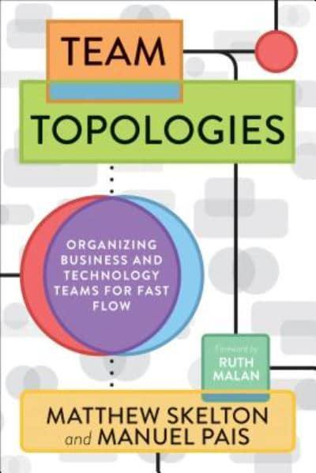
Teams on the ART are organized for flow
Stream-aligned team – organized around the flow of work and has the ability to deliver value directly to the Customer or end user.
Complicated subsystem team – organized around specific subsystems that require deep specialty skills and expertise.
Platform team – organized around the development and support of platforms that provide services to other teams.
Enabling team – organized to assist other teams with specialized capabilities and help them become proficient in new technologies.
More information in the Advanced Topic Article, Organizing Agile Teams and ARTs: Team Topologies at Scale
Notes:
Trainer Guidance:
Another new body of knowledge we are integrating is Team Topologies. Currently this resides in an advanced topic article for which you can see the link on this slide.
This is now integrated into several articles such as Agile Teams, ARTs, Solution Train and the Implementation Roadmap.
One of the questions that we often get is how do we organize the teams on the ARTs. In the past we have talked about feature and component teams, but we didn’t have much more than this in terms of useful organization patterns.
Recently a new book Team Topologies by Mathew Skelton and Manuel Pais was released that provides much more detail to help conquer this challenge.
These four topologies, that are shown on the slide here, are now the recommended patterns for team organization in SAFe.

Slide 15
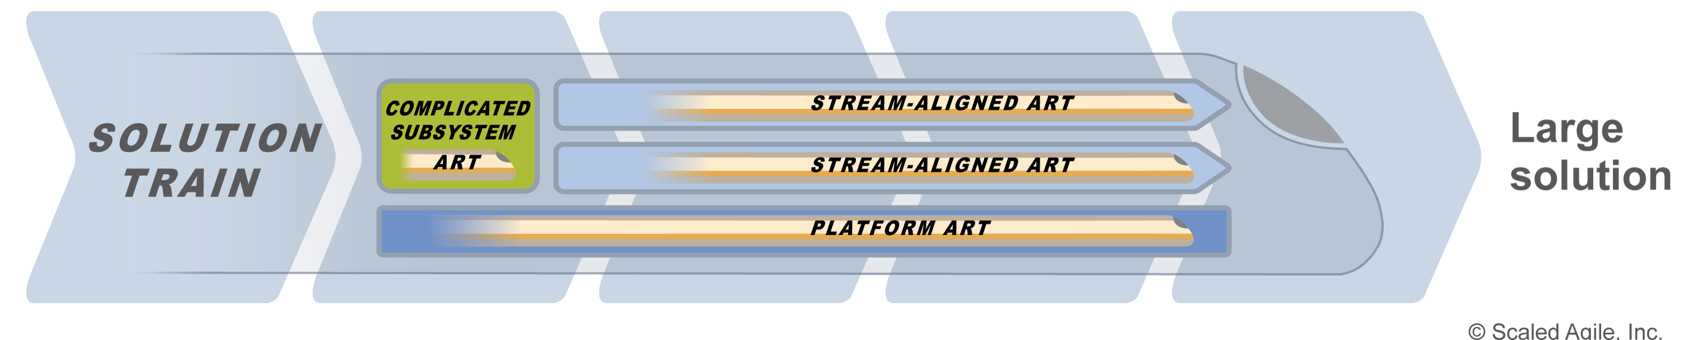
Organizing ARTs with ART Topologies in a Solution Train
Stream-aligned (best)
  By product, Solution, or service
  By Customer or market segment
  By Solution feature areas
  By value streamlets
  New product innovation
Complicated Subsystem
  Highly specialised system components
  Safety critical systems elements
  Specialty algorithm or business rules
  Part of a cyber-physical system
Platform
  Sets of services consumed by other ARTs
Notes:
Trainer Guidance:
And we have extended these topologies to the way that the ARTs are organized within a large solution.
Stream-aligned ART:
A stream-aligned ART, just like a stream-aligned team, will have the necessary personnel, skills, and authority to deliver value, whether it’s a full product, service, subsystem, or whatever portion of the solution they have been tasked with.
Complicated subsystem ART:
Most large systems also include extensive subsystems. This means that complicated subsystem ARTs are common when building large-scale systems, again to reduce the cognitive load on the stream-aligned ARTs. For example, a guidance system for an autonomous vehicle could well require an entire complicated subsystem ART.
Platform ART:
Similarly, it’s common for a Solution Train to have Platform ARTs providing services that the stream-aligned ARTs extend and build on. Continuing the example of the autonomous vehicle, a communication system that manages data transferred between the various subsystems would likely be represented as a platform ART, with clearly defined interfaces. One additional benefit of the platform topology is that it also supports a single platform ART that is providing services across multiple development value streams within the organization.

Slide 16


Participatory budgeting overview
Baseline
Solution Investments
Total Portfolio Budget and Guardrails
Run the Business (RtB) Solution Investments
Proposed
Solution
Initiatives
Grow the Business (GtB) Epics Investments
Business Context
Current Value Stream Budgets
New Value Stream Budgets
Participatory Budgeting Forums
Notes:
Trainer Guidance:
The next significant new article is Participatory Budgeting (PB).
Although its not new as such, since it was released last year as an advanced topic article and has been part of the implementing SAFe and Lean Portfolio Management courses for a while now.
As shown here PB is the way that the total Portfolio budget is allocated to the development value streams within the Portfolio.
To do this we need to come to an agreement about the right mix of work for the Portfolio. This is what participatory budgeting helps us achieve.

Slide 17
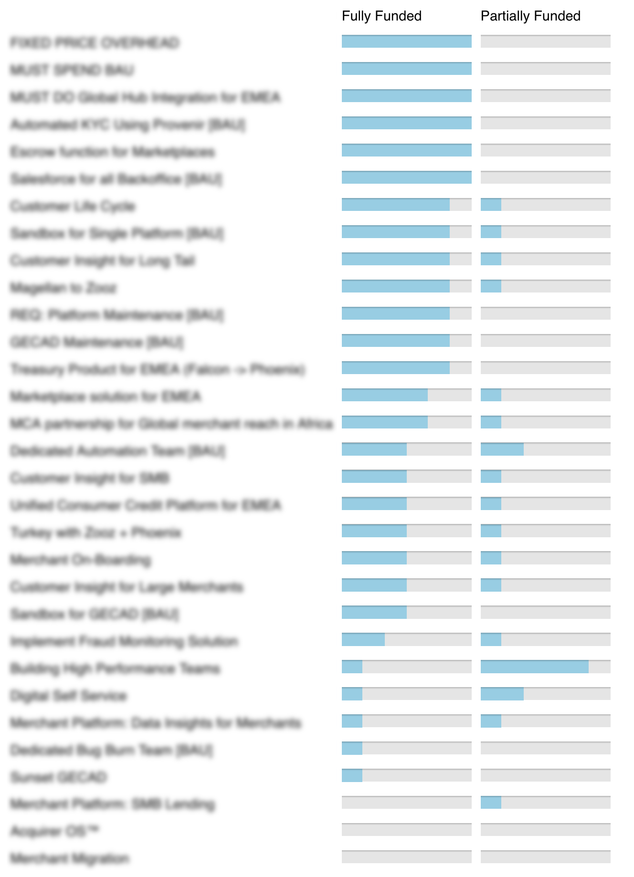
Running a participatory budgeting event
Participatory budgeting is a significant event that requires preparation, coordination, and communication.
1
Prepare the content
2
Assemble the participants
3
Conduct the forums
4
Analyze results
Business Context
Business Owners
Total Portfolio Budget and Guardrails
Epic Owners
System/Solution Architects
Baseline
Solution Investments
Run the Business (RtB) Solution Investments
Proposed
Solution
Initiatives
Grow the Business (GtB) Epic Investments
Product/Solution Management
Notes:
Trainer Guidance:
The nice thing about the article is that it runs through an example of how to facilitate a PB event in the four steps shown on this slide.
The inputs to the event, box 1, include the business context, the Strategic Themes, the Portfolio Roadmap and the total budget.
A proposal set of baseline solution investments are prepared which represent the run the business costs to support continued funding in existing solutions.
And a set pf proposed solution initiatives, which are then those new Epics under consideration. Both sets of costs are estimated over an agreed budgetary period, typically 6 months if this event is happening twice a year.
The participants for this event should represent all the value streams in the portfolio and after a suitable briefing during which the business context and the various costs and associated business cases are presented, they are organized into cross functional groups and the PB forums are conducted.
The forums consist of each group being given the total available Portfolio budget and through discussion and debate and making tradeoffs until they arrive at a decision to fund, partially or not fund a mix of baseline solution investments and proposed solution initiatives that they feel will best deliver against the strategy, knowing that they can never fund everything.
Although the final funding decisions are not taken in the forum itself the data from each of these forums is hugely insightful since it encapsulates multiple opinions, and is then used to inform the decisions being taken by the lean portfolio management team

Slide 18
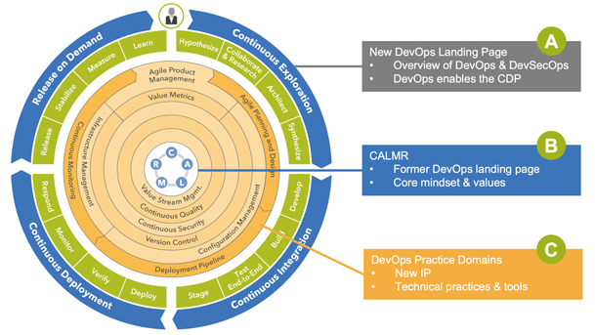

Dev(Sec)Ops landing page
Notes:
Trainer Guidance:
The next important article update is the new DevOps landing page accessible from the new icon. This will lead directly to a page that will provide an overview on the topic marked with an A in the list above
From there you can access the CALMR page – CALMR describes the mindset and values of DevOps – culture, automation, Lean flow, Measurement and Recovery.
But there will also be a brand-new page, shown in orange here dedicated to DevOps Practice Domains. What we are addressing is the need for the teams to have the technical skills to implement and sustain DevOps.
We have always taught the mindset but now we need to teach the practices to enable and develop a Continuous Delivery Pipeline. DevOps is not easy. Lots of different components, a sea of tools and lots of skills and complexity in shifting left that puts a burden on the teams. The teams are looking for the best guidance they can get and when you are doing this at scale this is especially difficult. This will now be part of SAFe.

Slide 19
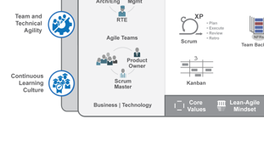
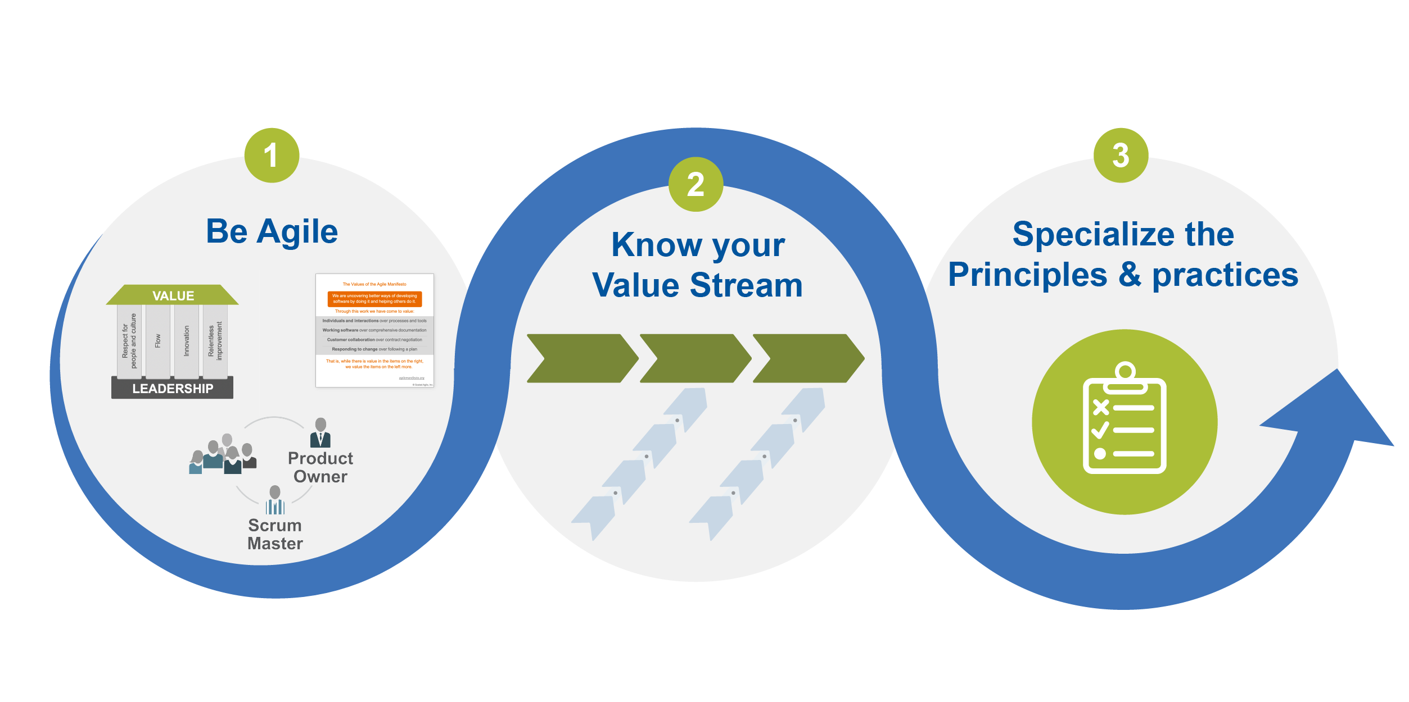
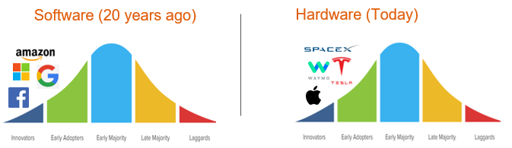
Business and Technology landing page
New landing page for domain-specific Agile team guidance
  Business
  Agile HR (existing whitepaper)
  Agile Marketing (existing whitepaper)
  Agile Contracts (existing whitepaper)
  more to follow…
  Technology
  Hardware (new article)
  Software (summarize existing SAFe guidance)
Notes:
Trainer Guidance:
Another addition to the Big Picture was the Business and Technology landing page in the bottom left hand corner. This will be an area on the Big Picture that will be used to link off to further guidance.
On the left we are bringing together some existing bodies of knowledge around Agile HR, Contracting and the brand new whitepaper on Agile Marketing.
Again this content is there if you know where to look for it, but we want to bring it to the forefront. Extending agility across the organization is critical to achieving the goal of business agility.
This guidance here follows the steps we describe in our agile teams maturity cycle and for each domain describes how they can get started as an agile team, know their value stream and where they need to work to contribute value and then how they can adapt the practices and principles to fit the work they do.
And the on the right we can see that they are starting to experience the same innovation in the hardware domain that we saw in software 20 years ago. So included in this landing page will be a link to a specific article on applying SAFe to Hardware teams. Alongside of course, a deep article collecting together all the excellent guidance we have for software teams.

Slide 20
5.1 Courseware and Toolkits

Slide 21





Updated 5.1 Courses
All four courses updated and enhanced with new SAFe 5.1 big picture images and content
New style guide incorporated across the courses
Introduced ‘Topic & Learning Objectives’ structure to improve flow and learner outcomes
Numerous improvements and fixes including remote guidance and course timings
New Course Delivery Enablement (CDE) videos for Leading SAFe and SAFe for Teams
Leading
SAFe®
Implementing
SAFe®
Lean Portfolio
Management
SAFe® for
Teams
Notes:
Trainer Guidance:
Not all courses are impacted by these changes. We have focused on the four courses that are immediately affected.

Slide 22


Updated 5.1 Toolkits
All five toolkits updated with the latest SAFe 5.1 big picture images and content
Incorporated the latest guidance on value streams and ARTs into the VSAIW toolkit
Brand new Team Formation Toolkit (out now)
Introducing SAFe
SAFe Executive Workshop
SAFe® Value Stream and ART Identification Workshop
Team Formation Toolkit
SAFe LPM Execution Toolkit
Notes:
Trainer Guidance:
On this slide you can see the toolkits, available from the community platform, that have been updated to 5.1

Slide 23
Thank You

