Slide 1
Introducing SAFe® 5
Your Operating System for Business Agility

Slide 2


“
Those who master large-scale software delivery will define the economic landscape of the 21st century.
—Mik Kersten
Notes:
Trainer Guidance:
Welcome to the software age—an interconnected, real-time world in which every industry is dependent on technology and every organization (at least in part) is a software company. To remain competitive, enterprises need to digitally transform their operations, business solutions, and customer experience. The larger challenge in many enterprises’ is that their current business models, organizational hierarchy, and technology infrastructure can’t keep pace with the rapid change required.
Our discussion today is about competing in the age of software. The creator of the Framework have been inspired by some new works in the field including Mik Kersten's new book Project to Product and John Kotter’s new book XLR8 (phonetic ‘accelerate’).
Studying technological trends, Kersten concludes that those who master large-scale software delivery will define the economic landscape of the 21st century.
That's a bold statement. But when you look at the combined revenue of Facebook, Apple, Amazon, Netflix and Google, you’ll see that the economics of the world have changed, dramatically.
If the Global 2000 doesn't get to the same level of competence that these unicorns have achieved, the balance of power will be eventually end up in the hands of these few companies and that’s not a healthy thing.

Slide 3
Five technological revolutions
Installation Period
Turning Point
Deployment Period
1771
1793-1801
Industrial Revolution
Canal Mania (UK)
Great British Leap
1829
1848-1850
Age of Steam & Railways
Railway Mania (UK)
The Victorian Boom
1875
1890-1895
Age of Steel & Heavy Engineering
London funded global market
infrastructure build-up
Belle Epoque (Europe)
Progressive Era (USA)
1908
1929-1943
Age of Oil & Mass Production
The Roaring Twenties
Post-War Golden Age
1971
2000-?
Age of Software & Digital
Dotcom and internet mania;
Global finance and housing bubbles
?
Adapted from Technological Revolutions and Financial Capital, Carlota Perez
Notes:
Trainer Guidance:
In Technological Revolutions and Financial Capital, Carlota Perez plots the evolution of society, business, and financial capital based on technological revolutions that have occurred over the last few hundred years. She opines that these disruptive trends happen every generation or so. These include technology trends such as the ‘age of steel and heavy engineering,’ ‘age of oil and mass production,’ and others. She concludes that these technology revolutions radically alter society, first via a mass movement in financial (investment) capital, which then results in new production capital (goods and services).
Massive societal change, disruption, and a new economic order sets in. These are truly ‘world-shaking’ disruptions that occur with three distinct phases:
Installation Period – New technology and financial capital combine to create a ‘Cambrian explosion’ (a geological term for a relatively short time over which a large diversity of life-forms appeared) of new entrants.
Turning Point – Existing businesses either master the new technology or decline and become relics of the last age.
Deployment Period – Production capital of the new technological giants starts to take over.

Slide 4
Production capital follows financial capital
Installation Period – New technology and financial capital combine to create a ‘Cambrian explosion’ of new market entrants, disrupting entire industries from the previous age
Turning Point – Existing businesses either master the new technology or decline and become relics of the last age
Deployment Period – Production capital of the new technological giants start to take over
Installation Period
Turning Point
Deployment Period
1971
2000-?
Age of Software & Digital
Dotcom and internet mania;
Global finance and housing bubbles
?

Slide 5

What stage are we in?
"BMW Group’s CEO expects that in their future more than half of its research and development staff will be software developers." (Mik Kersten, Project to Product)
The market cap of Tesla ($464B market cap, $24B revenue) now exceeds the market cap of Ford ($33B market cap, $156B revenue) at a 14:1 value ratio (November 2020)
Apple is now the biggest watchmaker in the world (Investopedia 2019)
﻿
﻿
Notes:
Trainer Guidance:
So the questions arises as to where are we now? The data above would indicate that we are at, or past, the turning point. It ‘s astounding to witness that it seems to be easier for a digital company, like Tesla, to bring a software-based vehicle to market faster than all the might, money and accumulated knowledge of all car makers over the last 20 years. And look at Apple, now the largest watchmaker in the world by revenue. And the Apple Watch was only introduced in 2015!
This means we are in the midst of a technological revolution that creates an existential crisis for some of the worlds largest and most valuable enterprises in insurance, trading, finance and banking, manufacturing, medical technology, aviation, automotive, consumer products, and the list goes on. It seems like every business MUST be a software business now.

Slide 6
Competing in the age of software
“
The problem is not with our organizations realizing that they need to transform; the problem is that organizations are using managerial frameworks and infrastructure models from past revolutions to manage their businesses in this one.
—Mik Kersten
Notes:
Trainer Guidance:
In his analysis of this work and in his book, Project to Product, Kersten notes that with respect to production capital “The productivity of software delivery at enterprise organizations falls woefully behind that of the tech giants, and the digital transformations that should be turning the tide are failing to deliver business results.” This means that many large and successful enterprises today face an existential crisis, the distinctive competencies and massive tangible assets that got them there—distribution, real estate, manufacturing, retail, local banking centers, insurance agents—will not be adequate to assure survival in the digital age. But these leaders get it, so why is it so difficult to transform?

Slide 7

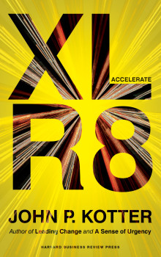
Rethinking the organization
“
The world is now changing at a rate at which the basic systems, structures, and cultures built over the past century cannot keep up with the demands being placed on them.
—John P. Kotter
Notes:
Trainer Guidance:
In his new book, Accelerate: Building Strategic Agility for a Faster-Moving World, renowned author and Harvard researcher John Kotter (author of the breakthrough text Leading Change) notes that the culture and management paradigms associated with the past technological revolutions have built a legacy of inflexible hierarchies that are unable to adapt to modern challenges. The question is how do we make that transition?

Slide 8
We started with a network
Notes:
Trainer Guidance:
In Accelerate, Kotter illustrates that successful enterprises don’t start as large and cumbersome. Rather, they typically began as a fast-moving, adaptive network of motivated individuals aligned to a common vision and focused on the needs of their customers. Roles and reporting relationships are fluid, and people collaborate organically to identify customer needs, explore potential solutions, and deliver value in any way they can. In other words, it’s an adaptive ‘entrepreneurial network’ of people working towards a shared, customer-centric purpose

Slide 9
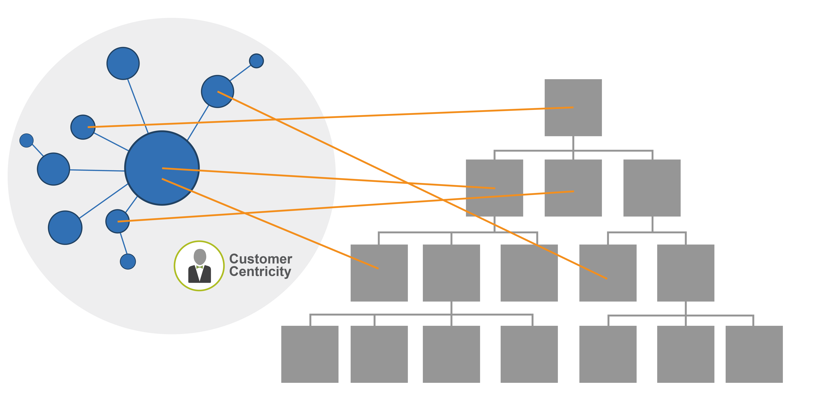
We added hierarchy for stability and execution
Notes:
Trainer Guidance:
As the enterprise succeeds, it naturally wants to expand on its success and grow. This means that individual responsibilities must become clearer to ensure that critical tasks are carried out. To add expertise, specialists are hired. Departments are created. Policies and procedures are established to ensure legality and compliance and to drive repeatable, cost-efficient operations. The business starts to organize by function. Silos begin to form. Meanwhile, operating in parallel, the network continues to seek new opportunities to deliver value.

Slide 10
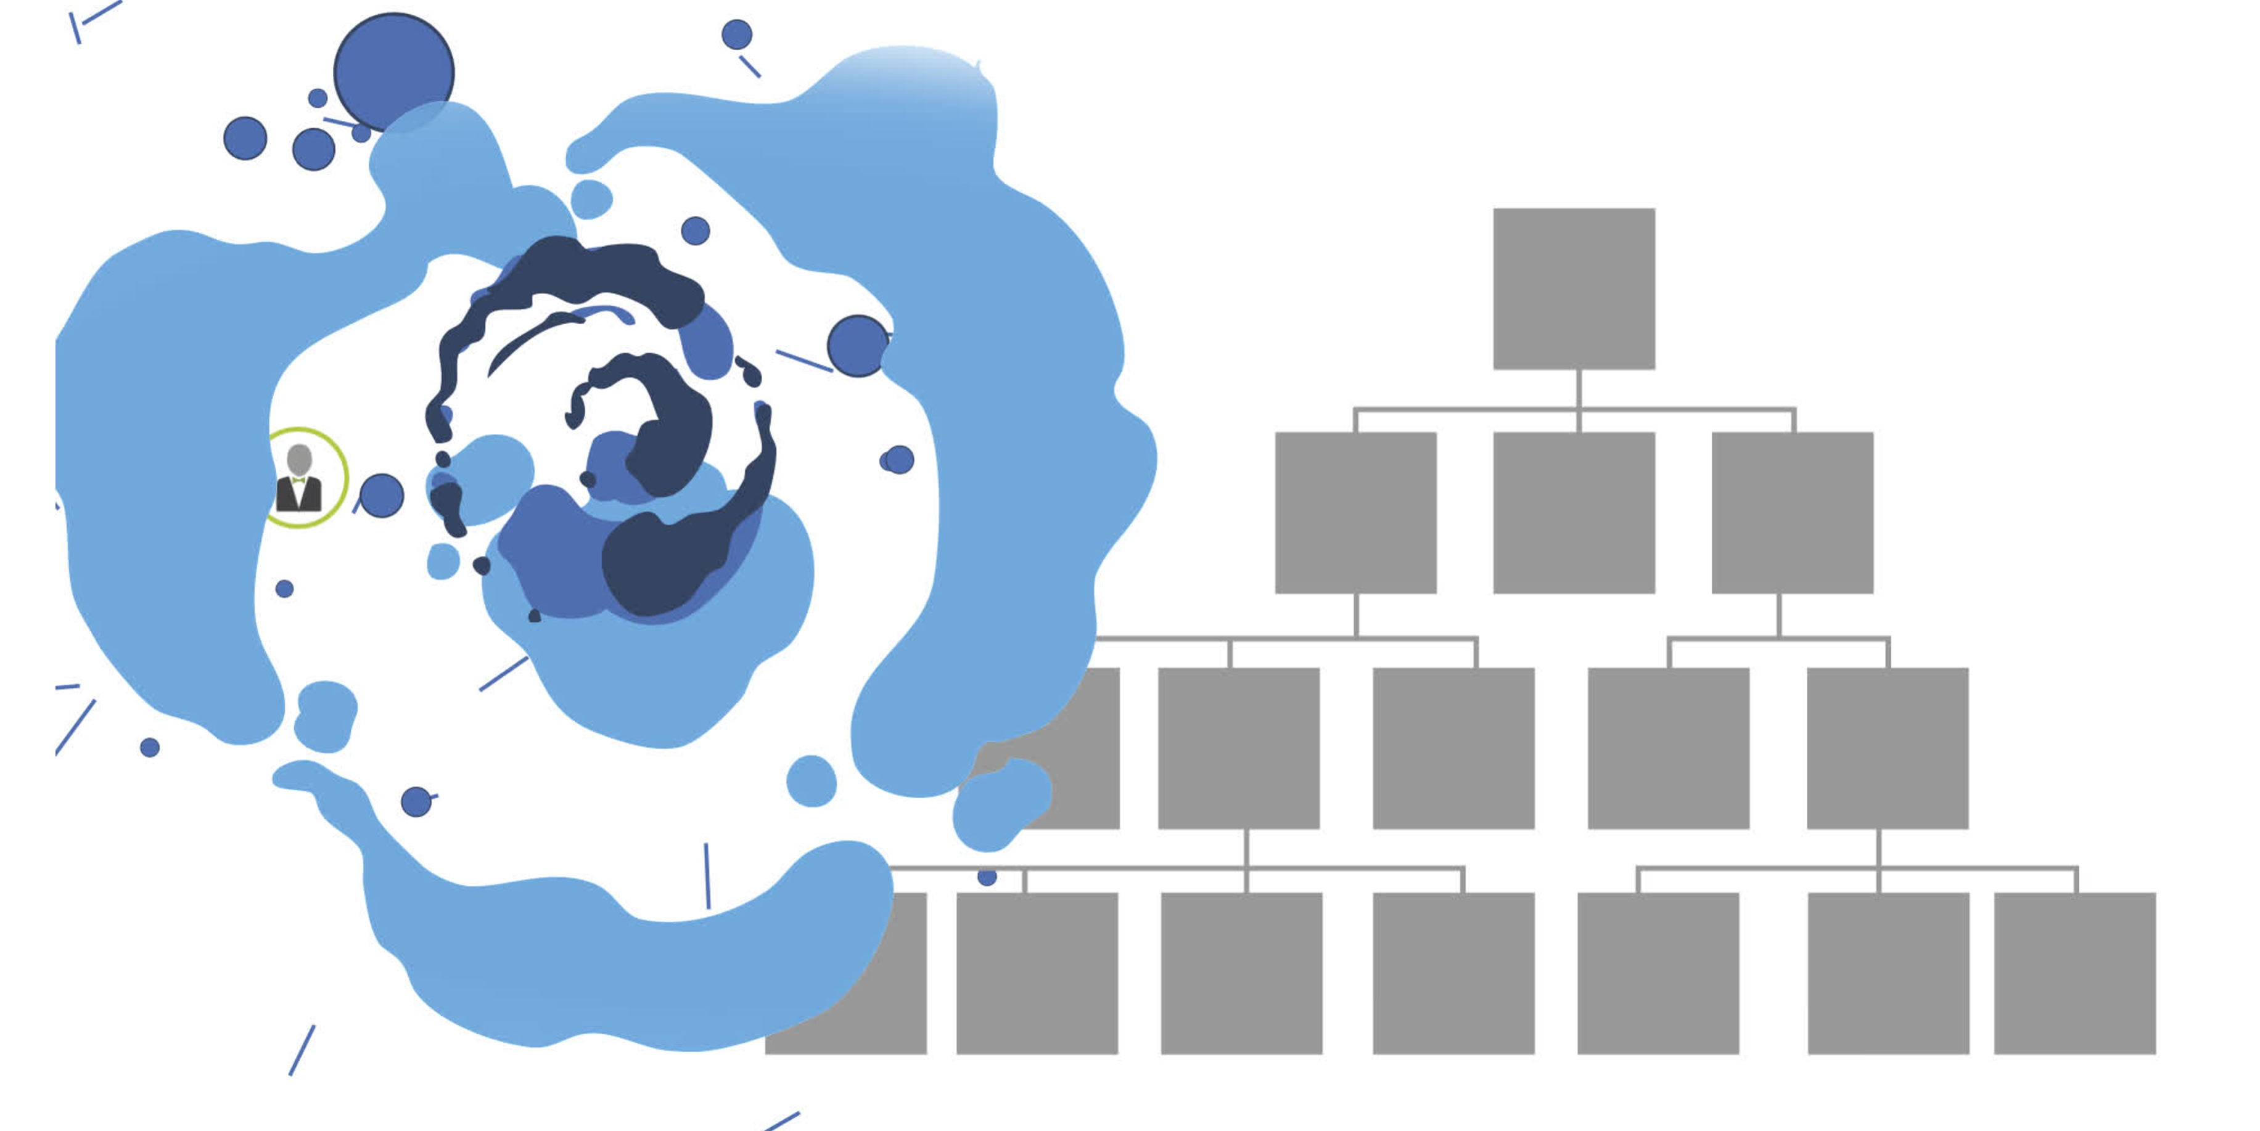
Guess what happens?
Notes:
Trainer Guidance:
To achieve increasing economies of scale, the hierarchy continues to grow. And grow. However, by assuming the practices and responsibilities incumbent on large businesses, it begins to conflict with the entrepreneurial network. With the authority of current revenue and profitability needs behind it, the hierarchical organization collides with the faster-moving, more adaptive network. The result? The network gets crushed in the process. Customer centricity is one of the casualties.

Slide 11
“
The solution is not to trash what we know and start over but instead to reintroduce a second system—one which would be familiar to most successful entrepreneurs.
—John P. Kotter
Notes:
Trainer Guidance:
So, what’s to be done? Kotter notes that the solution is not to trash what we know and start over. But instead to re-introduce a second operating system
We still need the hierarchy system that drives the current revenue model, provides the efficiency and stability, keeps the heat, power, and lights on, and sells and maintains their products and services. But we need a second system that adds the Agility back. One that focuses on providing the customer with new solutions that address emerging opportunities and problems. One that is nimble, adaptable, and vale stream based.

Slide 12

We need a dual operating system for Business Agility
Efficiency and stability
Speed of innovation
Notes:
Trainer Guidance:
The organizational hierarchies that we’ve built over the last fifty years have done a great job of providing time-tested structures, practices, and policies. They support the recruiting, retention, and growth of thousands of employees across the globe. Simply put, they are still needed. But the question becomes, how to organize and reintroduce the entrepreneurial network?
In addressing the dilemma, Kotter points out, “The solution is not to trash what we know and start over but instead to reintroduce a second system.” This model, which Kotter calls a ‘dual operating system’, restores the speed and innovation of the entrepreneurial network while leveraging the benefits and stability of the hierarchical system.

Slide 13
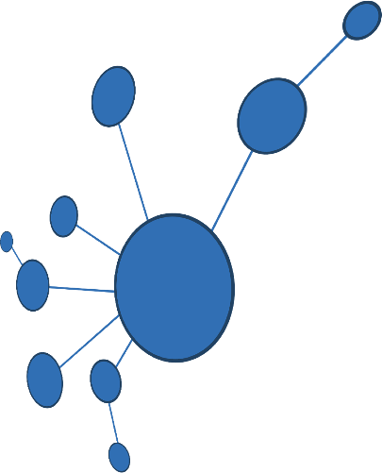
And we have just such an operating system at our fingertips
Value Stream network
Functional hierarchy
Notes:
Trainer Guidance:
So how do we create such a dual operating system? By organizing the second operating system around value streams instead of departments, SAFe offers a way for enterprises to focus on customers, products, innovation, and growth. Moreover, this operating system is flexible. It is built on time tested Lean, Agile, and SAFe practices, and it can organize and quickly reorganize without completely disrupting the existing hierarchy. That’s what Business Agility demands.

Slide 14
Responsibilities
Network
Hierarchy
Product research, development, delivery, and evolution
Revenue & cost
Finance & accounting
Sales & marketing
Legal & governance
People & careers
Production of goods and services
Shared
Strategy
Customer engagement
Support
Learning Culture

Slide 15
Optimize for performance
Network
Hierarchy
Speed of Innovation:
Self organizing
Constantly evolving
Fast and furious
Innovative/
Experimental
Fail fast
Short-term memory
Exploit variability
Efficiency and stability:
Standing organization
Stable
Slow and steady
Predictable/
Reliable
Don’t fail
Long-term memory
Reduce variability

Slide 16

Every business is a software business now. Achieving a state of Business Agility means that the entire organization—not just development—is engaged in continually and proactively delivering innovative business solutions faster than the competition.
“
—Dean Leffingwell, Creator of SAFe
Notes:
Trainer Guidance:
Many companies in traditional industries are becoming software companies. Banks, insurance companies, automotive, and more, all are affected by software in fundamental ways. Most capital investments include a technology component, regardless of company size or industry. Achieving a state of business agility means all aspects of the business—including marketing—is involved in delivering high-quality, innovative solutions to the market faster than the competition. The business can only go as fast as its slowest part. In short, what we are talking about is a mindset shift.

Slide 17
Business Agility requires technical agility and a business-level commitment to product and value stream thinking.
And it requires that everyone involved in delivering business solutions use Lean and Agile practices.
17
Notes:
Trainer Guidance:
While the benefits are clear, before an enterprise can gain SAFe’s substantial business benefits, it must transform itself into a Lean enterprise.
This transformation requires developing new ‘enterprise competencies’ that enable a new style of leadership, new ways of thinking and working, and a culture focused on value delivery and continuous improvement.

Slide 18


Business Agility requires Agility in both
Network
Hierarchy
Lean-Agile Mindset
Lean, Agile, DevOps principles and practices
Optimizing development value streams
Lean-Agile Mindset
Agile Marketing
Agile Contracts
Agile HR
Optimizing operational value streams

Slide 19
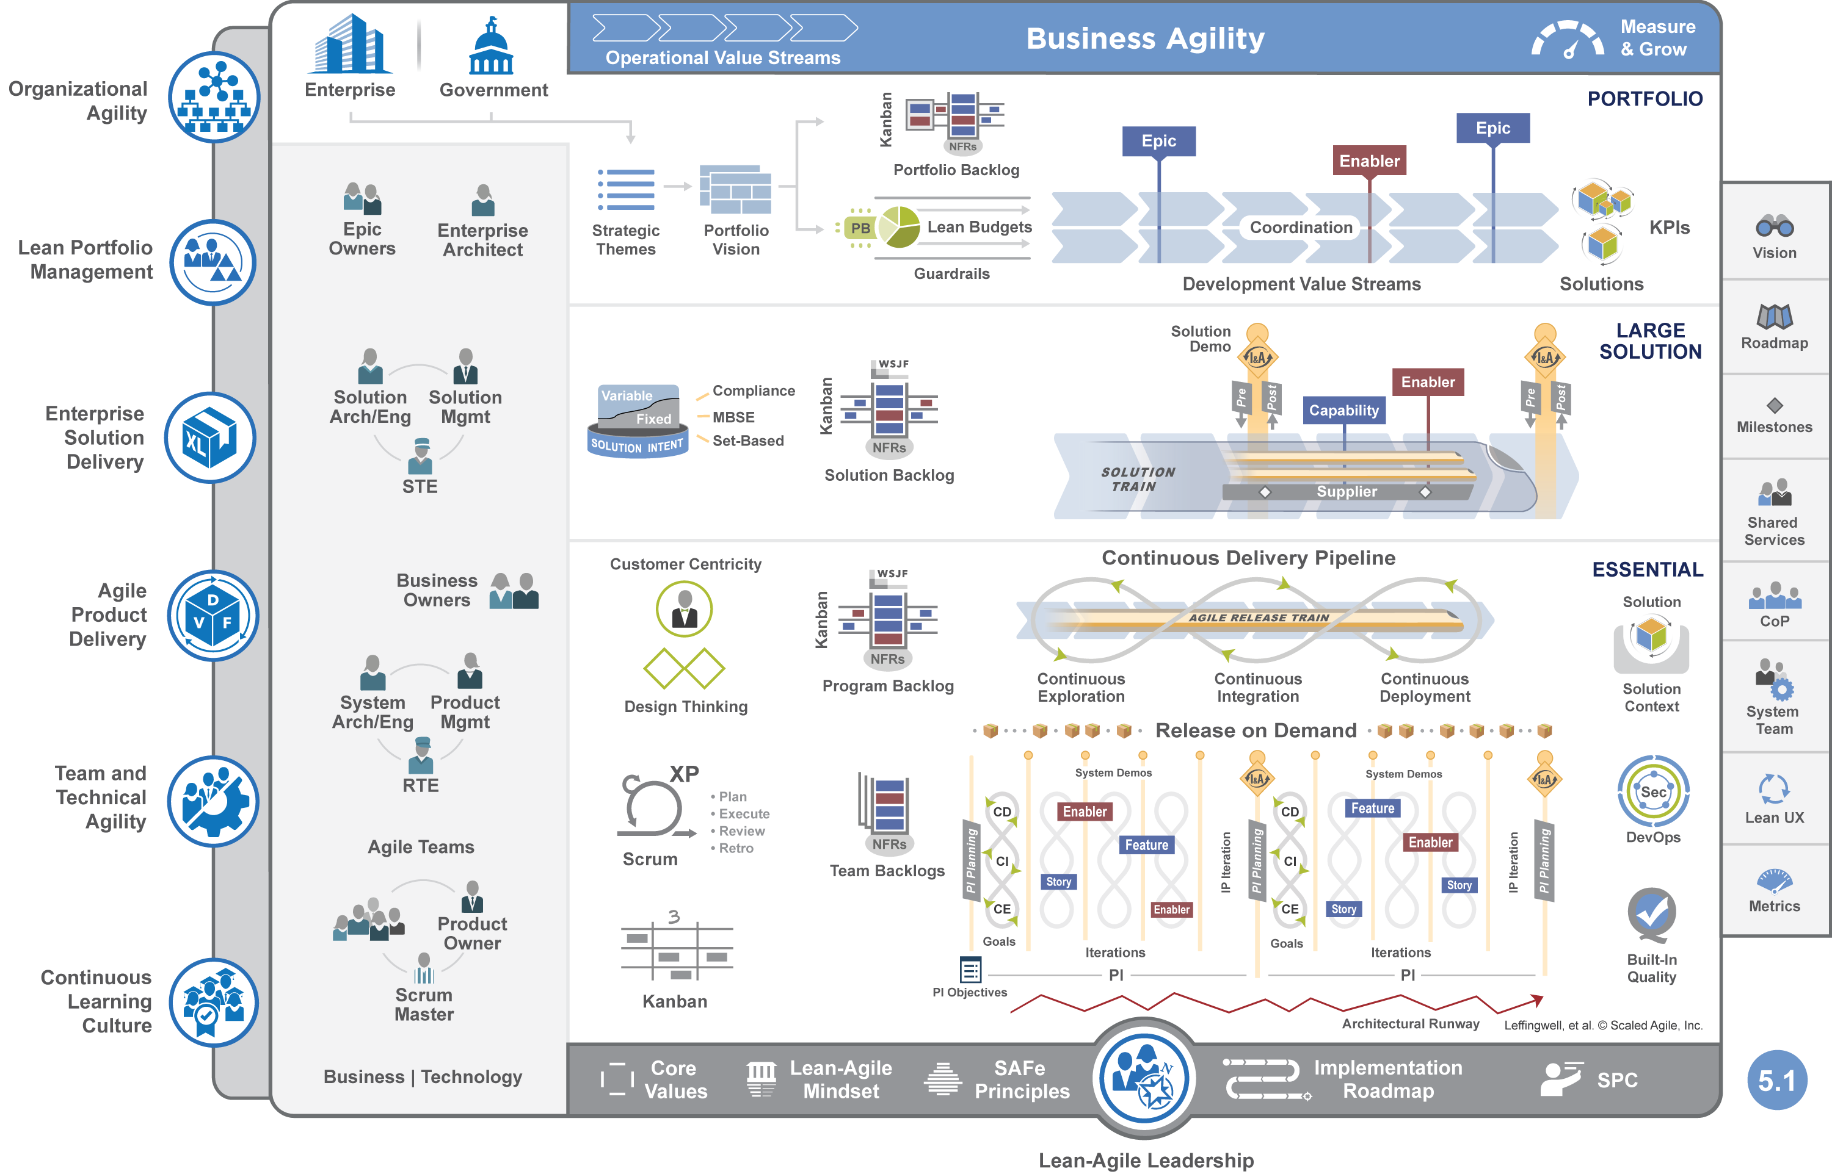
19
Notes:
Trainer Guidance:
The Scaled Agile Framework applies the power of Agile, along with the contemporary knowledge found in systems thinking and Lean product development to help businesses address the significant challenges of developing and delivering enterprise-class technology-based solutions with high quality and fast time-to-market. It is an online, freely-revealed knowledge base of proven success patterns for achieving business agility.

Slide 20
The world’s leading framework
for business agility
SAFe integrates the power of Lean, Agile, and DevOps into a comprehensive operating system that helps enterprises thrive in the digital age by delivering innovative products and services faster, more predictably, and with higher quality.
scaledagileframework.com
20
Notes:
Trainer Guidance:
The practices of SAFe are freely available of the framework website.
These have been proven to work in an integrated fashion in many organizations.

Slide 21
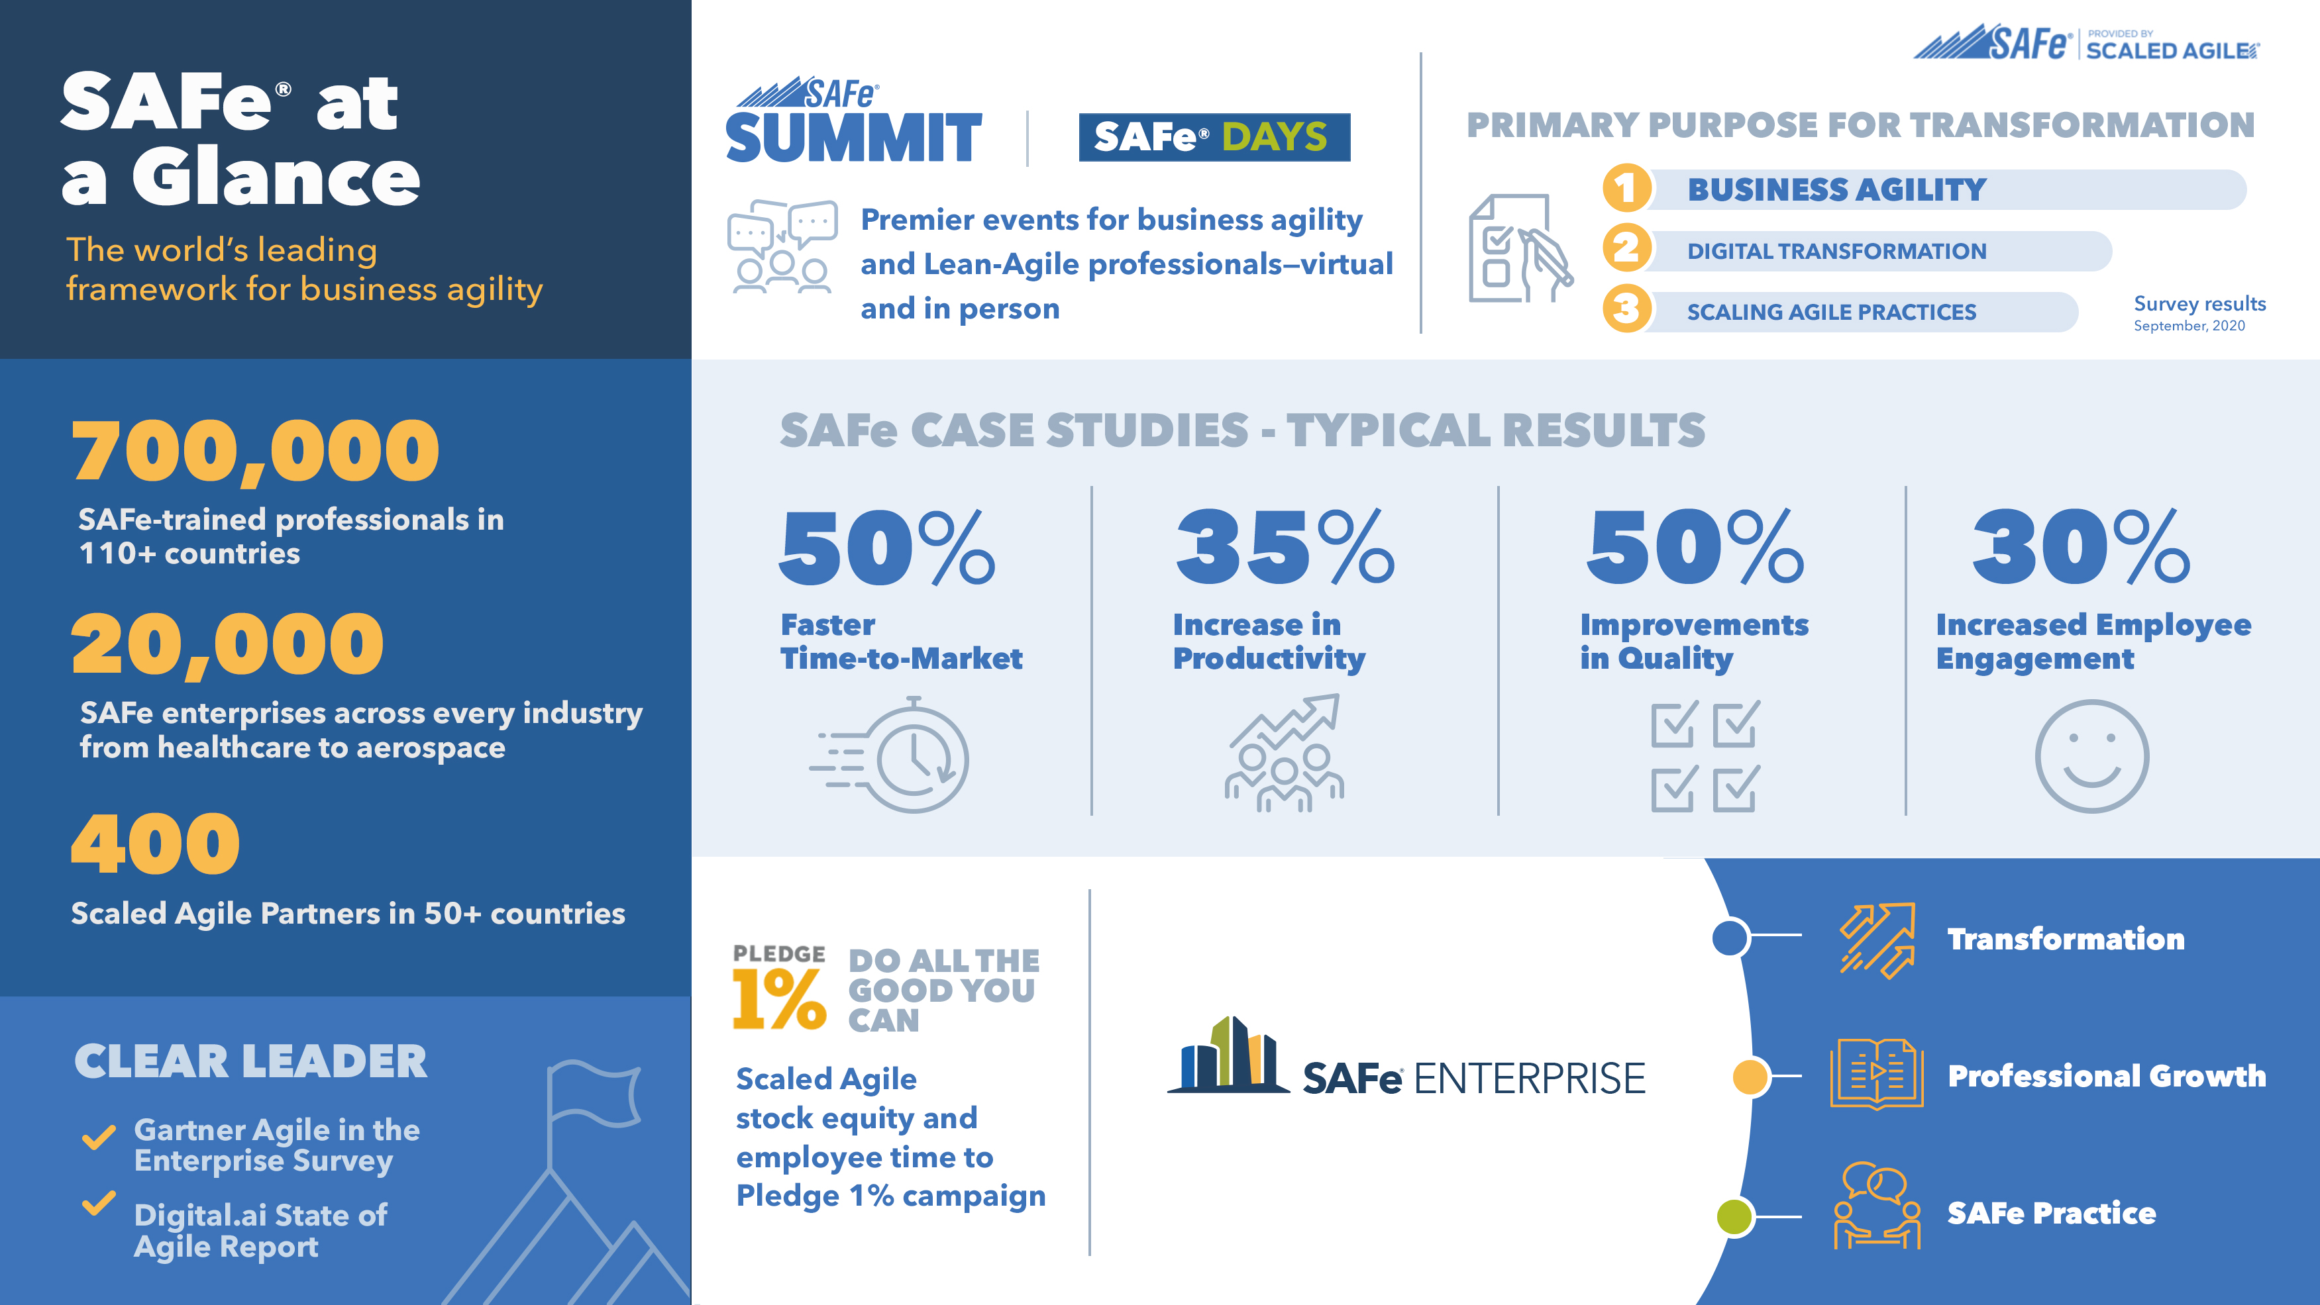
’
Notes:
Trainer Guidance:
By adopting SAFe—and applying its well-described set of values, principles, and practices—the enterprise can address these questions and realize greater business and individual benefits. Now in its sixth major revision, SAFe 5.0 is enabling business agility and improving business outcomes for organizations of all sizes across the world. SAFe has produced dramatic improvements in time to market, employee engagement, higher quality, higher customer satisfaction, and overall improved economic outcomes. It also helps create cultures that are more productive, rewarding, and fun. The figure on this slide highlights these benefits.

Slide 22
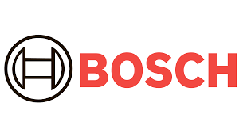









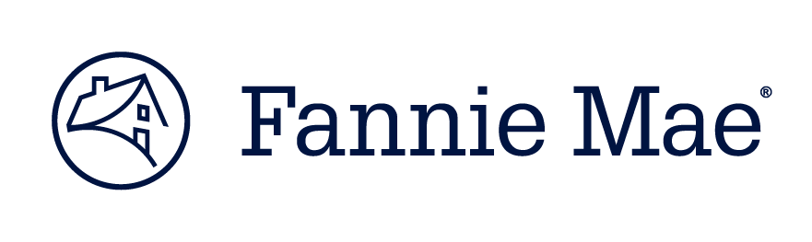




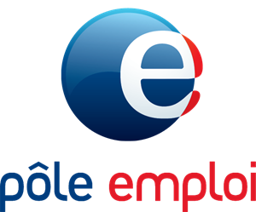
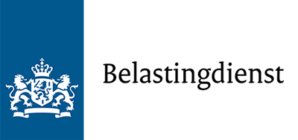



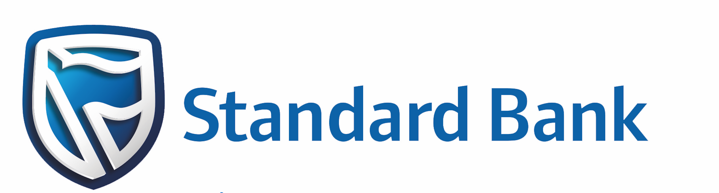
Within enterprise and government
(Dutch Tax Administration)
scaledagile.com/customer-stories
22
Notes:
Trainer Guidance:
These numbers and results come from the companies themselves, both private and public enterprises.
We don’t influence them. We simply gather the data from the enterprises and publish them.
Go to the website and you’ll see over 40 documented customer stories on SAFe right now.
scaledagileframework.com/customer-stories

Slide 23
The Seven Core Competencies of Business Agility

Slide 24
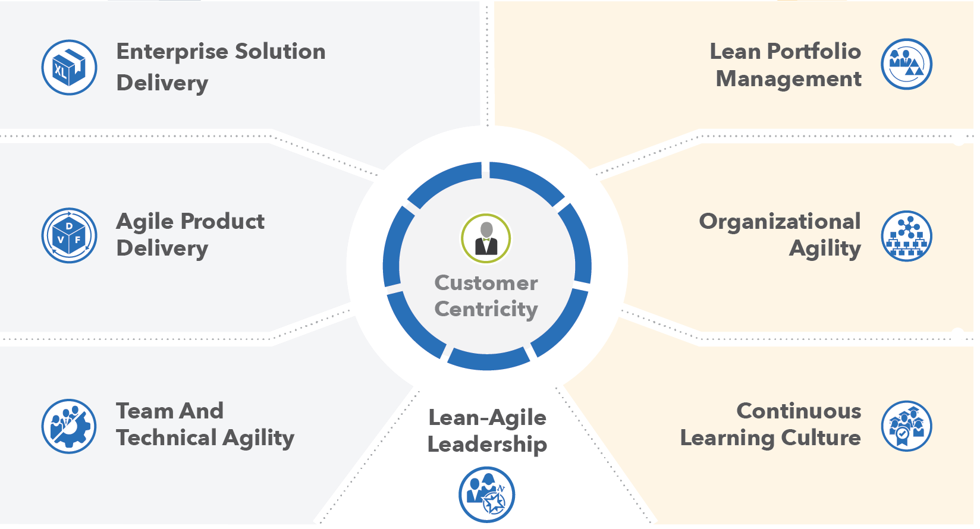
The Seven Core Competencies of Business Agility
Notes:
Trainer Guidance:
To achieve Business Agility, the organization requires a significant degree of expertise across seven core competencies. While each competency can deliverer value independently, they are also interdependent in that true Business Agility can be present only when the enterprise achieves a meaningful state of mastery of all competencies.

Slide 25
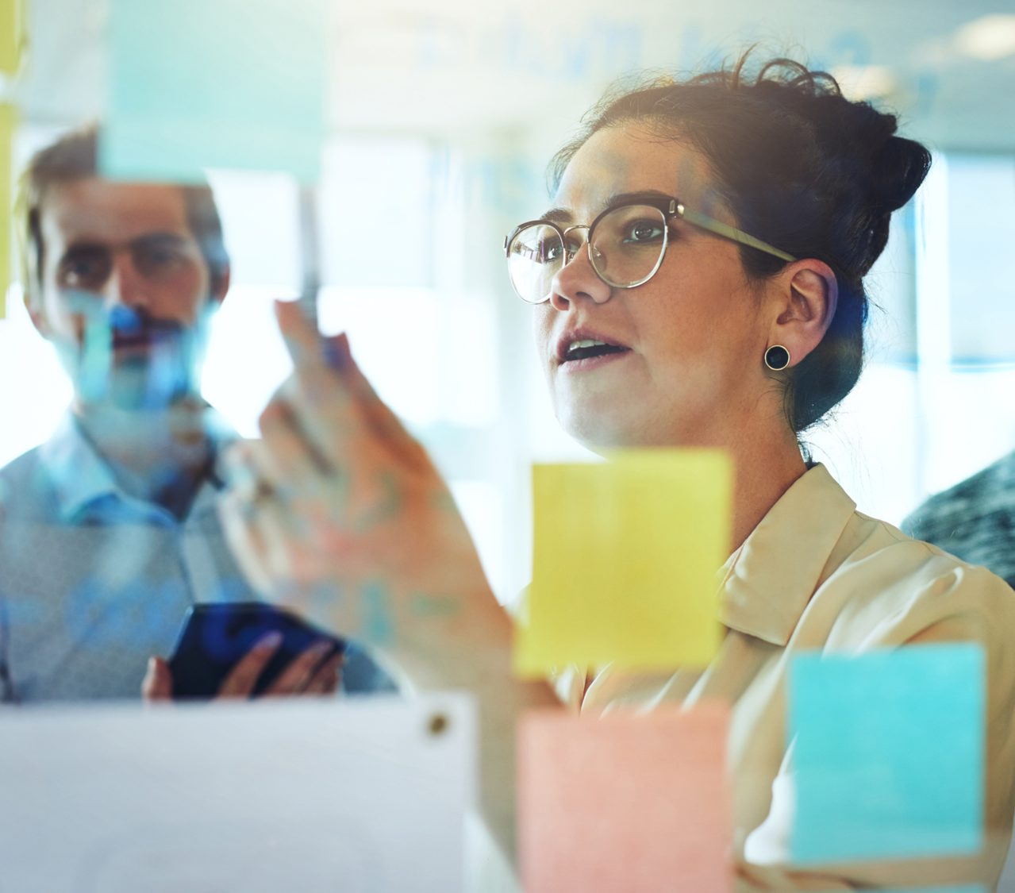
Why Lean-Agile
Leadership?
An organization’s managers, executives, and other leaders are responsible for the adoption, success, and ongoing improvement of Lean-Agile development and the competencies that lead to Business Agility. Only they have the authority to change and continuously improve the systems that govern how work is performed.

Slide 26

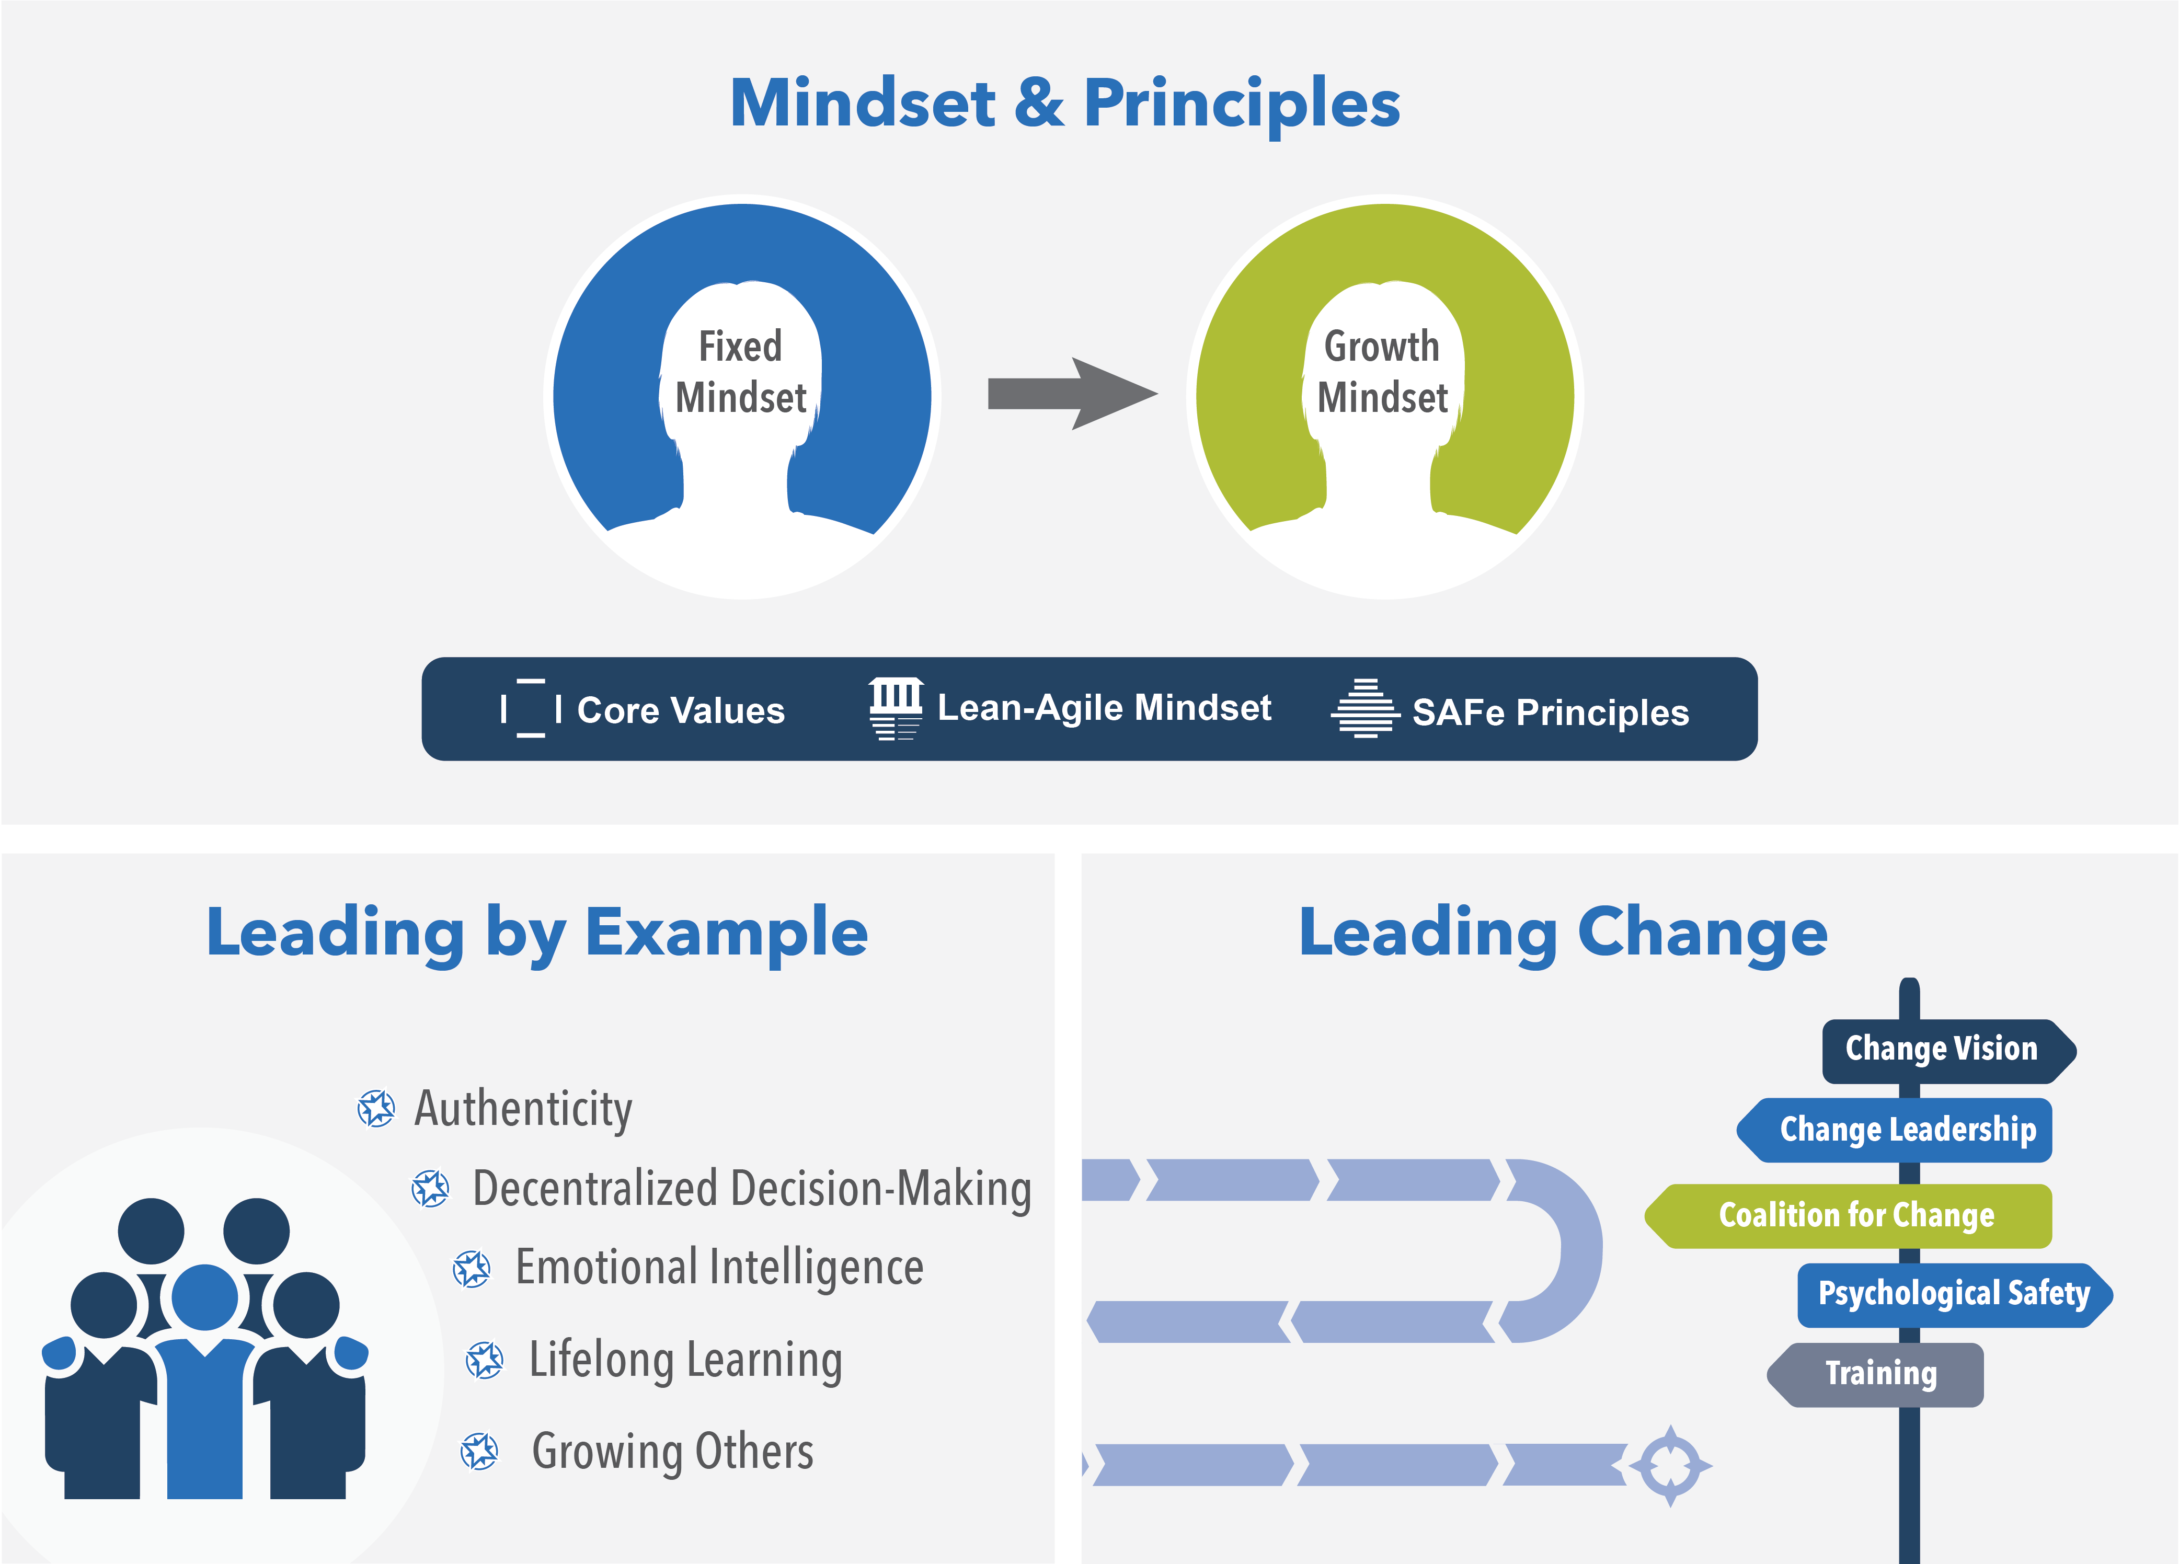
Lean-Agile Leadership
The Lean-Agile Leadership competency describes how Lean-Agile Leaders drive and sustain organizational change and operational excellence by empowering individuals and teams to reach their highest potential.
26
Notes:
Trainer Guidance:
The Lean-Agile Leadership competency describes how Lean-Agile Leaders drive and sustain organizational change and operational excellence by empowering individuals and teams to reach their highest potential.
Leading by Example – Leaders gain earned authority by modelling the desired behaviors for others to follow, inspiring them to incorporate the leader’s example into their development journey.
Mindset and Principles – By embedding the Lean-Agile way of working in their beliefs, decisions, responses, and actions, leaders model the expected norm throughout the organization.
Leading Change – Leaders lead (rather than support) the transformation by creating the environment, preparing the people, and providing the necessary resources to realize the desired outcomes.

Slide 27
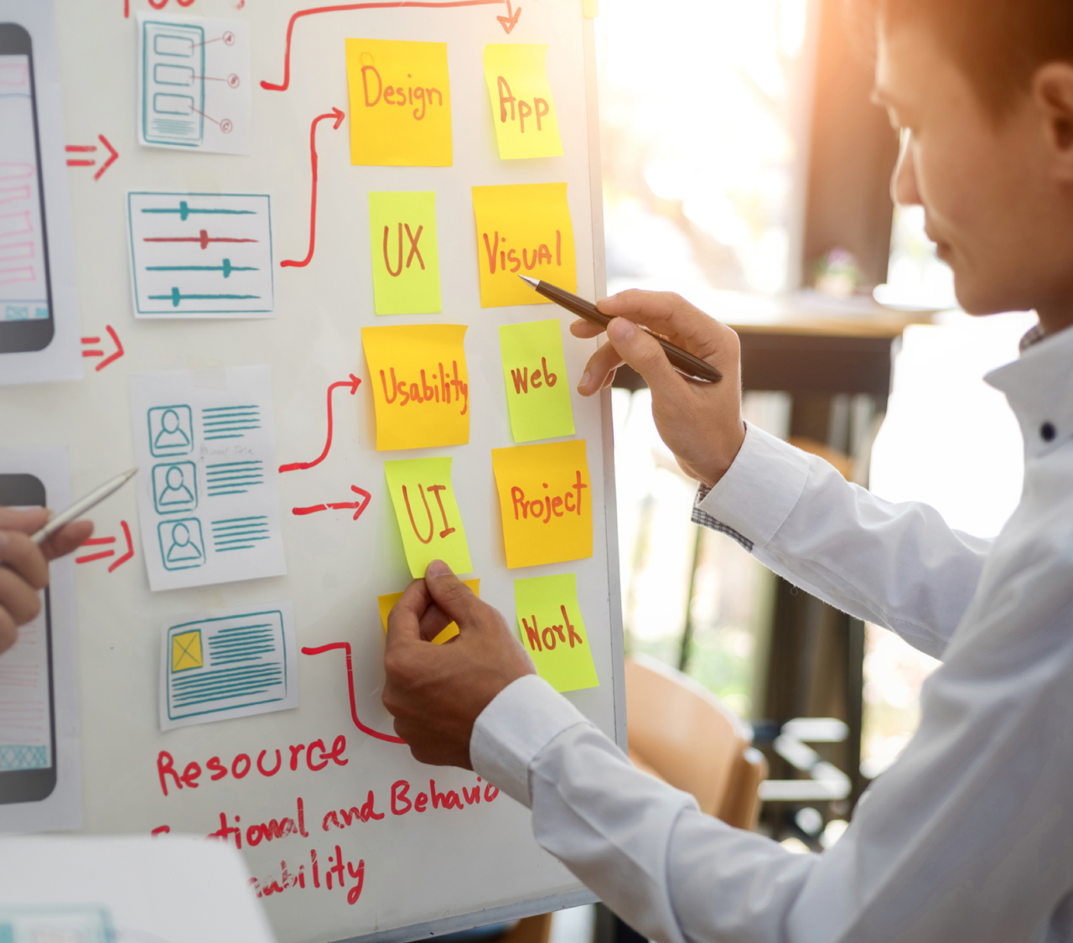
Why Team and
Technical Agility
Agile Teams and teams of Agile Teams create and support the business Solutions that deliver value to the Enterprise’s Customers. Consequently, an organization’s ability to thrive in the digital age is entirely dependent on the ability of its teams to deliver Solutions that reliably meet a Customer’s needs.

Slide 28
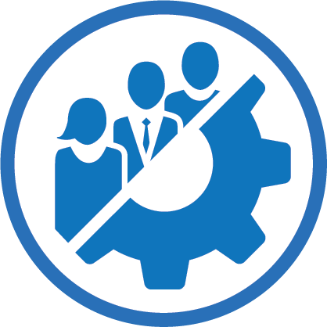
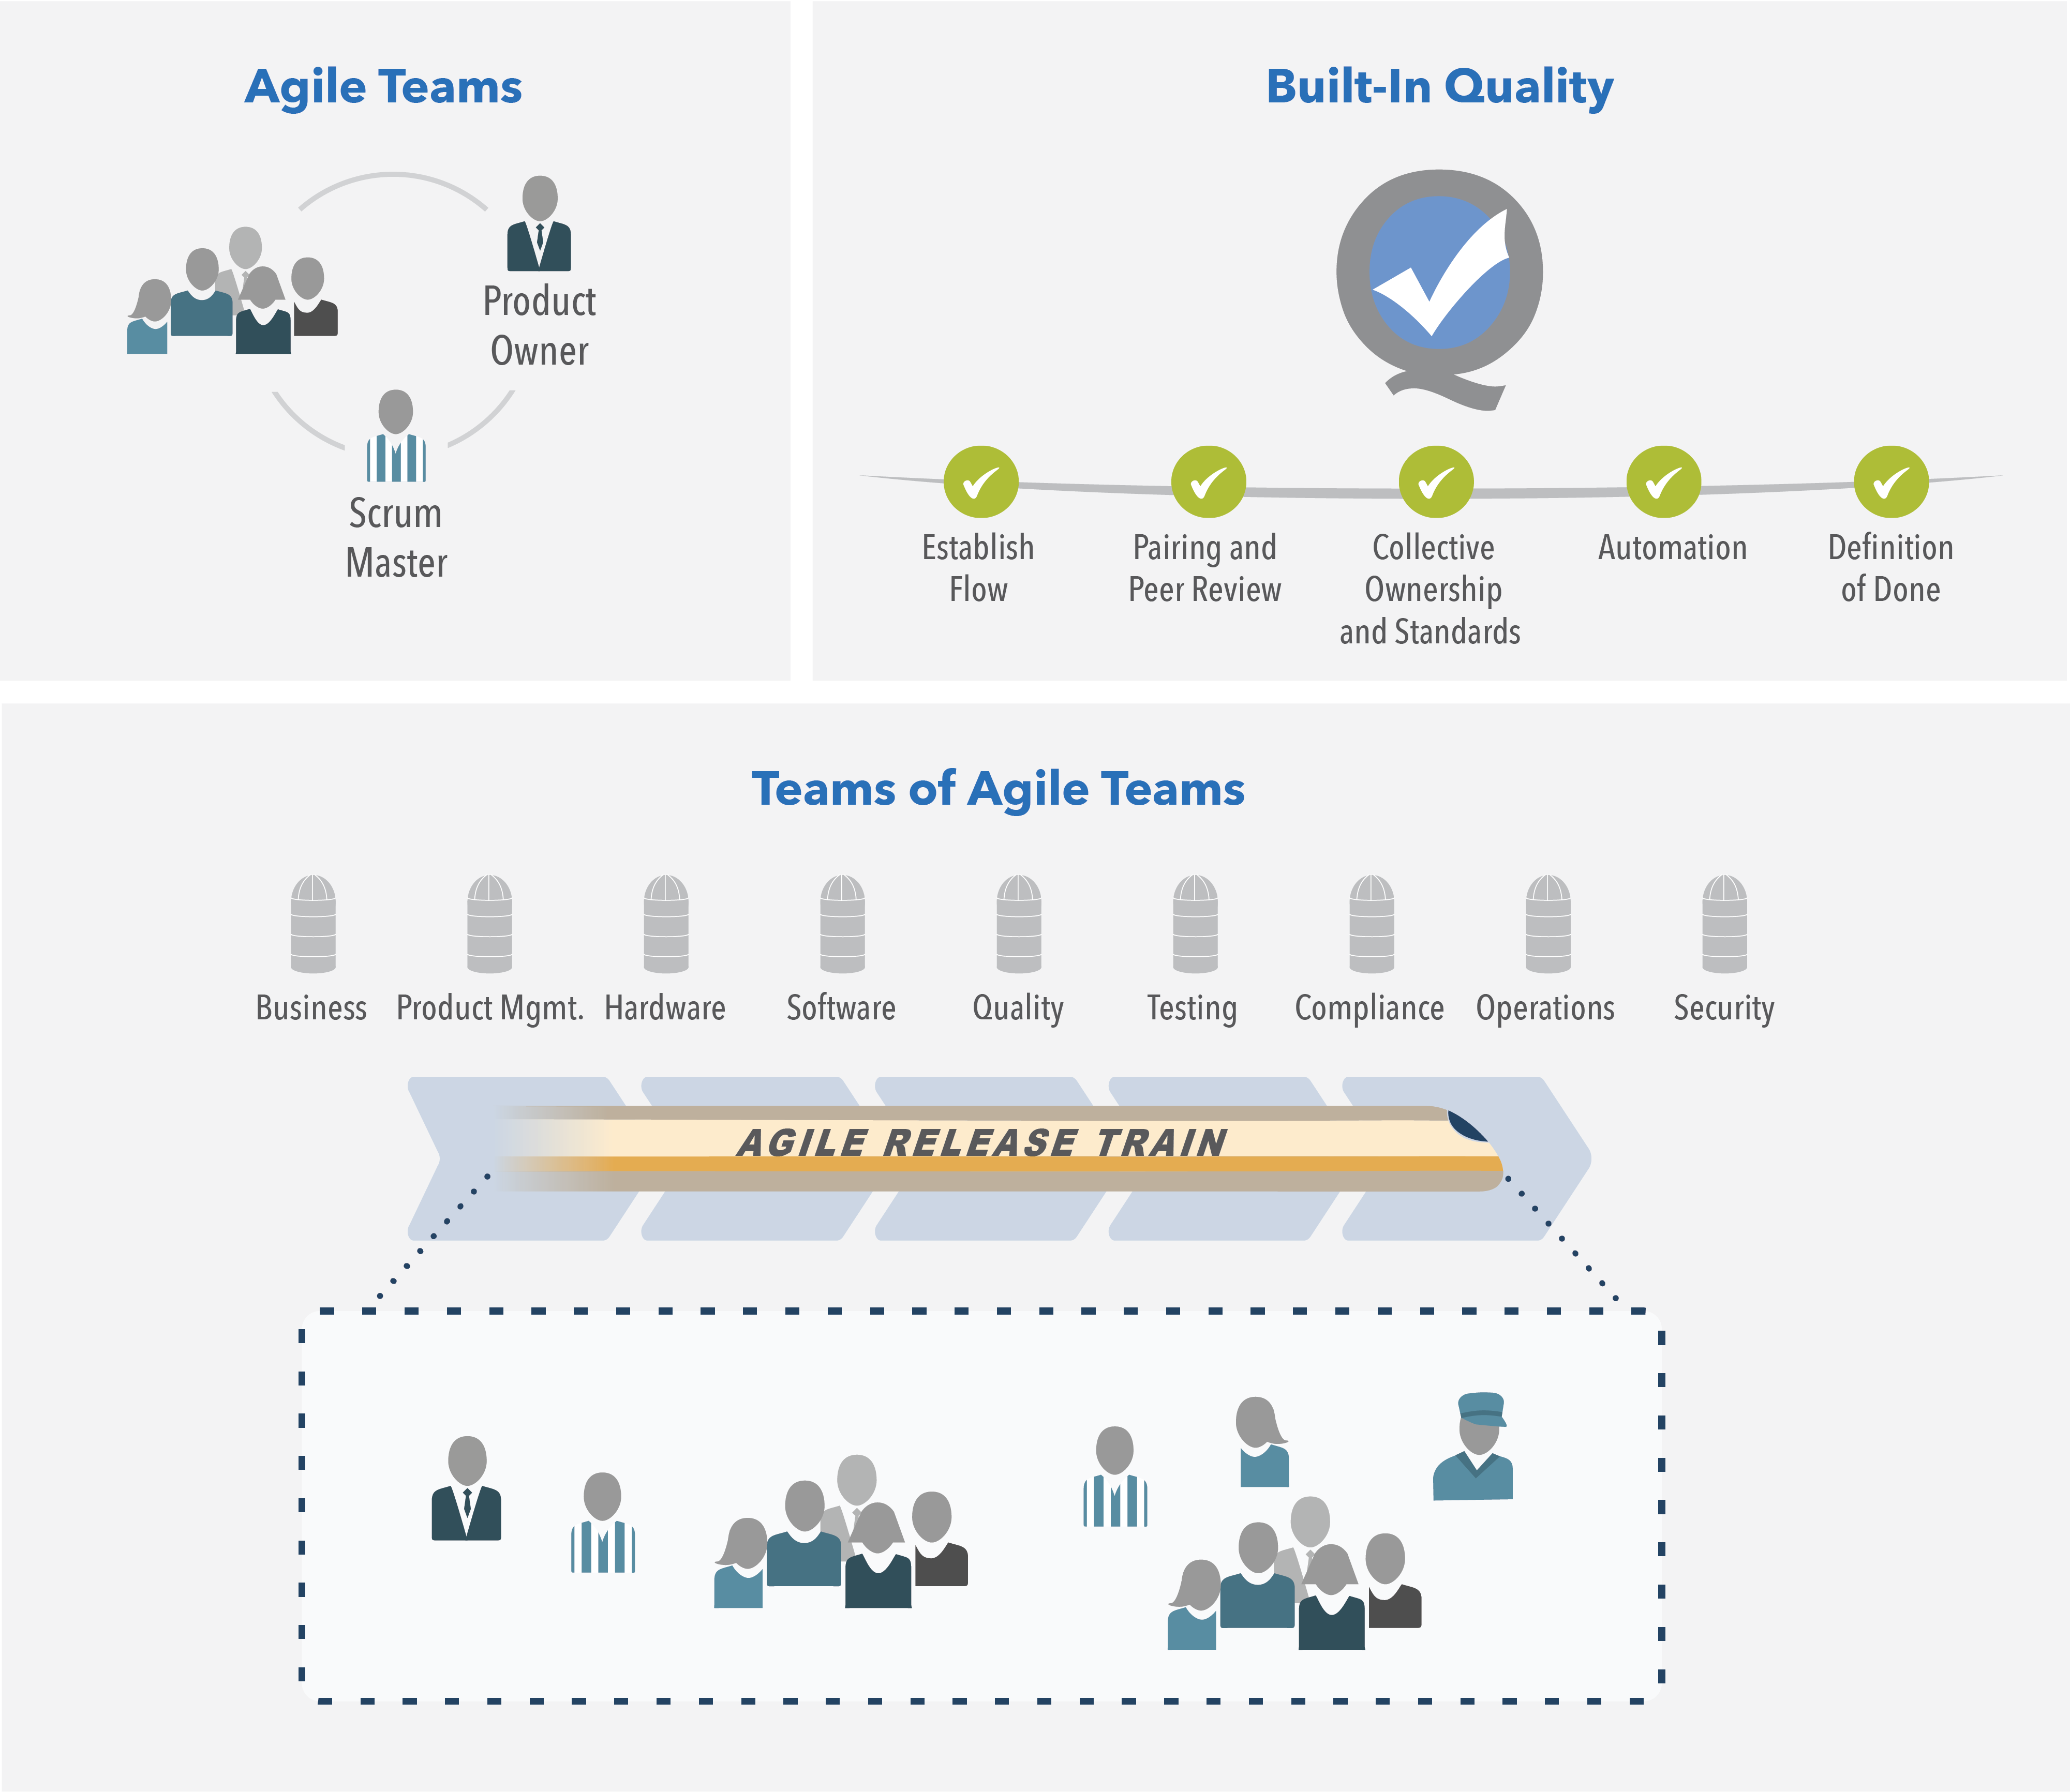

Team and Technical Agility
The Team and Technical Agility competency describes the critical skills and Lean-Agile principles and practices that high-performing Agile teams and Teams of Agile teams use to create high-quality solutions for their customers.
28
Notes:
Trainer Guidance:
The Team and Technical Agility competency describes the critical skills and Lean-Agile principles and practices that high-performing Agile teams and Teams of Agile teams use to create high-quality solutions for their customers.
Agile Teams – High-performing, cross-functional teams anchor the competency by applying effective Agile principles and practices.
Team of Agile Teams – Agile teams operate within the context of a SAFe Agile Release Train (ART), a long-lived, team of Agile teams that provides a shared vision and direction and is ultimately responsible for delivering solution outcomes.
Built-in Quality – All Agile teams apply defined Agile practices to create high-quality, well-designed solutions that support current and future business needs.

Slide 29

Why Agile
Product Delivery?
In order to achieve Business Agility, Enterprises must rapidly increase their ability to deliver innovative products and services. To be sure that the Enterprise is creating the right Solutions for the right Customers at the right time, they must balance their execution focus with a Customer focus.
29

Slide 30
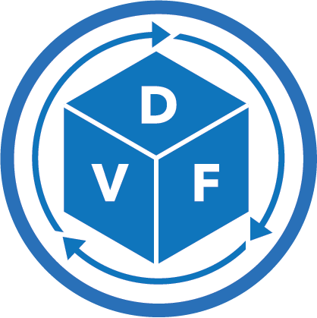
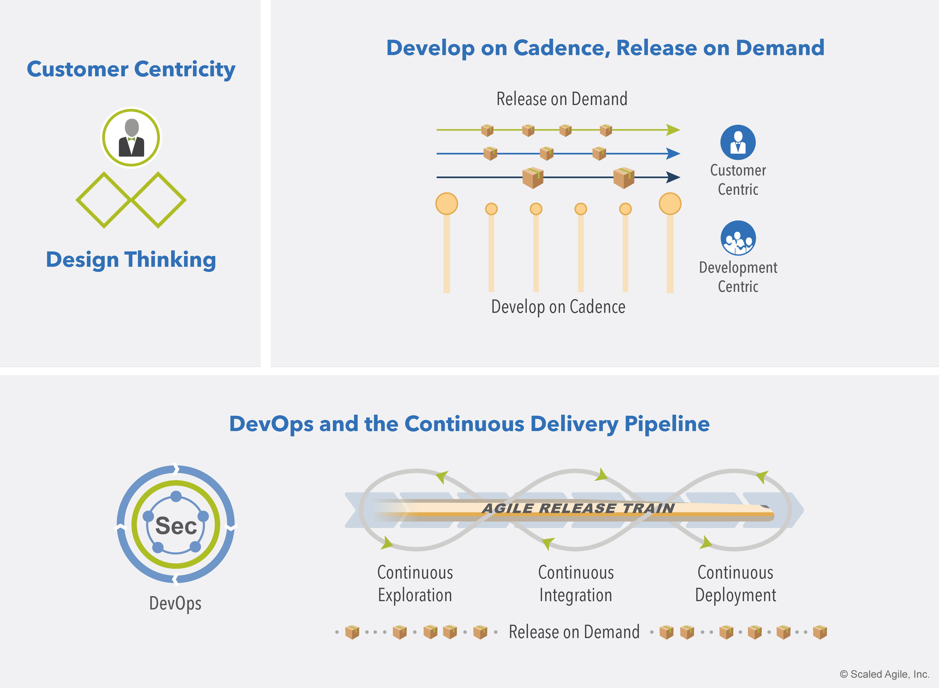
Agile Product Delivery
Agile Product Delivery is a customer-centric approach to defining, building, and releasing a continuous flow of valuable products and services to customers and users.
30
Notes:
Trainer Guidance:
Agile Product Delivery is a customer-centric approach to defining, building, and releasing a continuous flow of valuable products and services to customers and users.
Customer Centricity and Design Thinking – Customer centricity puts the customer at the center of every decision and uses design thinking to ensure the solution is desirable, feasible, viable, and sustainable. Develop on Cadence;
Release on Demand – Developing on cadence helps manage the variability inherent in product development. Decoupling the release of value from that cadence ensures customers can get what they need when they need it.
DevOps and the Continuous Delivery Pipeline – DevOps and the Continuous Delivery Pipeline creates the foundation that enables enterprises to release value, in whole or in part, at any time it’s needed.

Slide 31
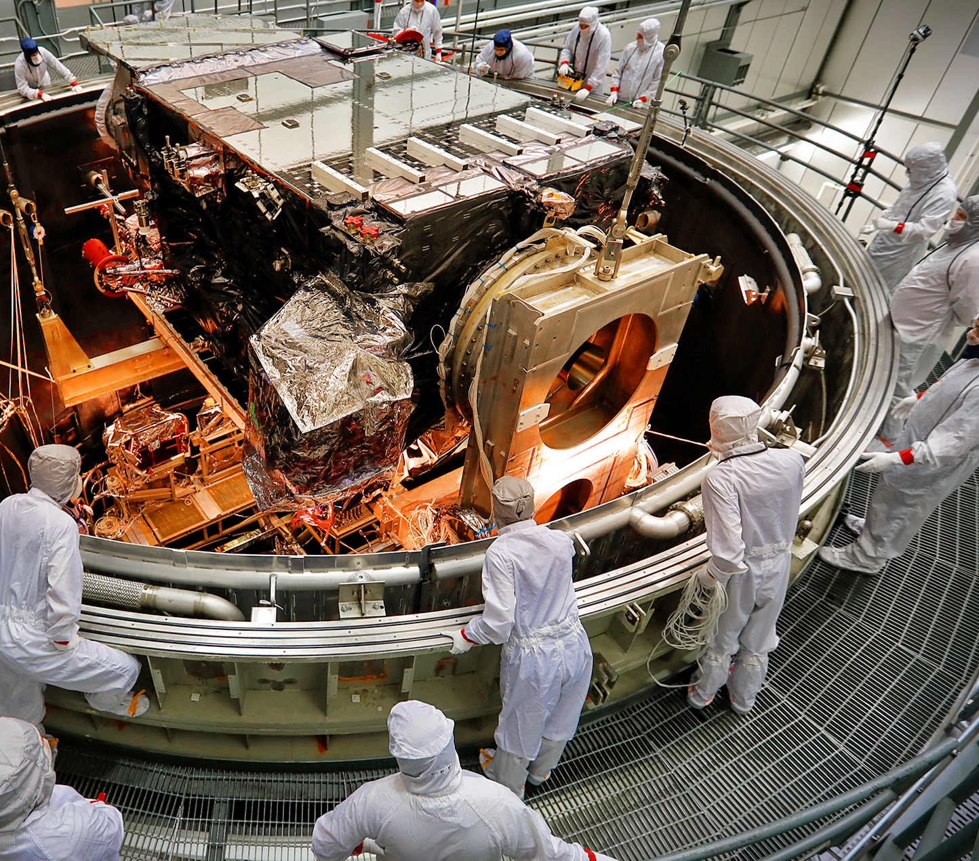
Why Enterprise
Solution Delivery?
Humanity has always dreamed big; and scientists, engineers, and software developers then turn those big dreams into reality. That requires innovation, experimentation, and knowledge from diverse disciplines. Engineers and developers bring these innovations to life by defining and coordinating all the activities to successfully specify, design, test, deploy, operate, evolve, and decommission large, complex solutions.
Enterprise Solution Delivery
Courtesy NASA Goddard

Slide 32
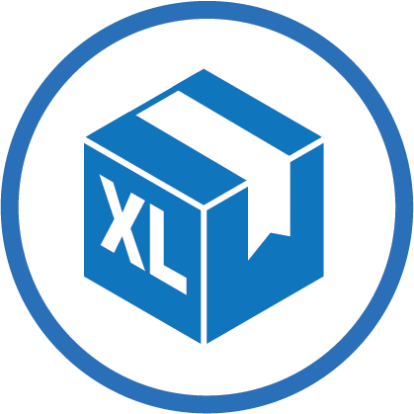
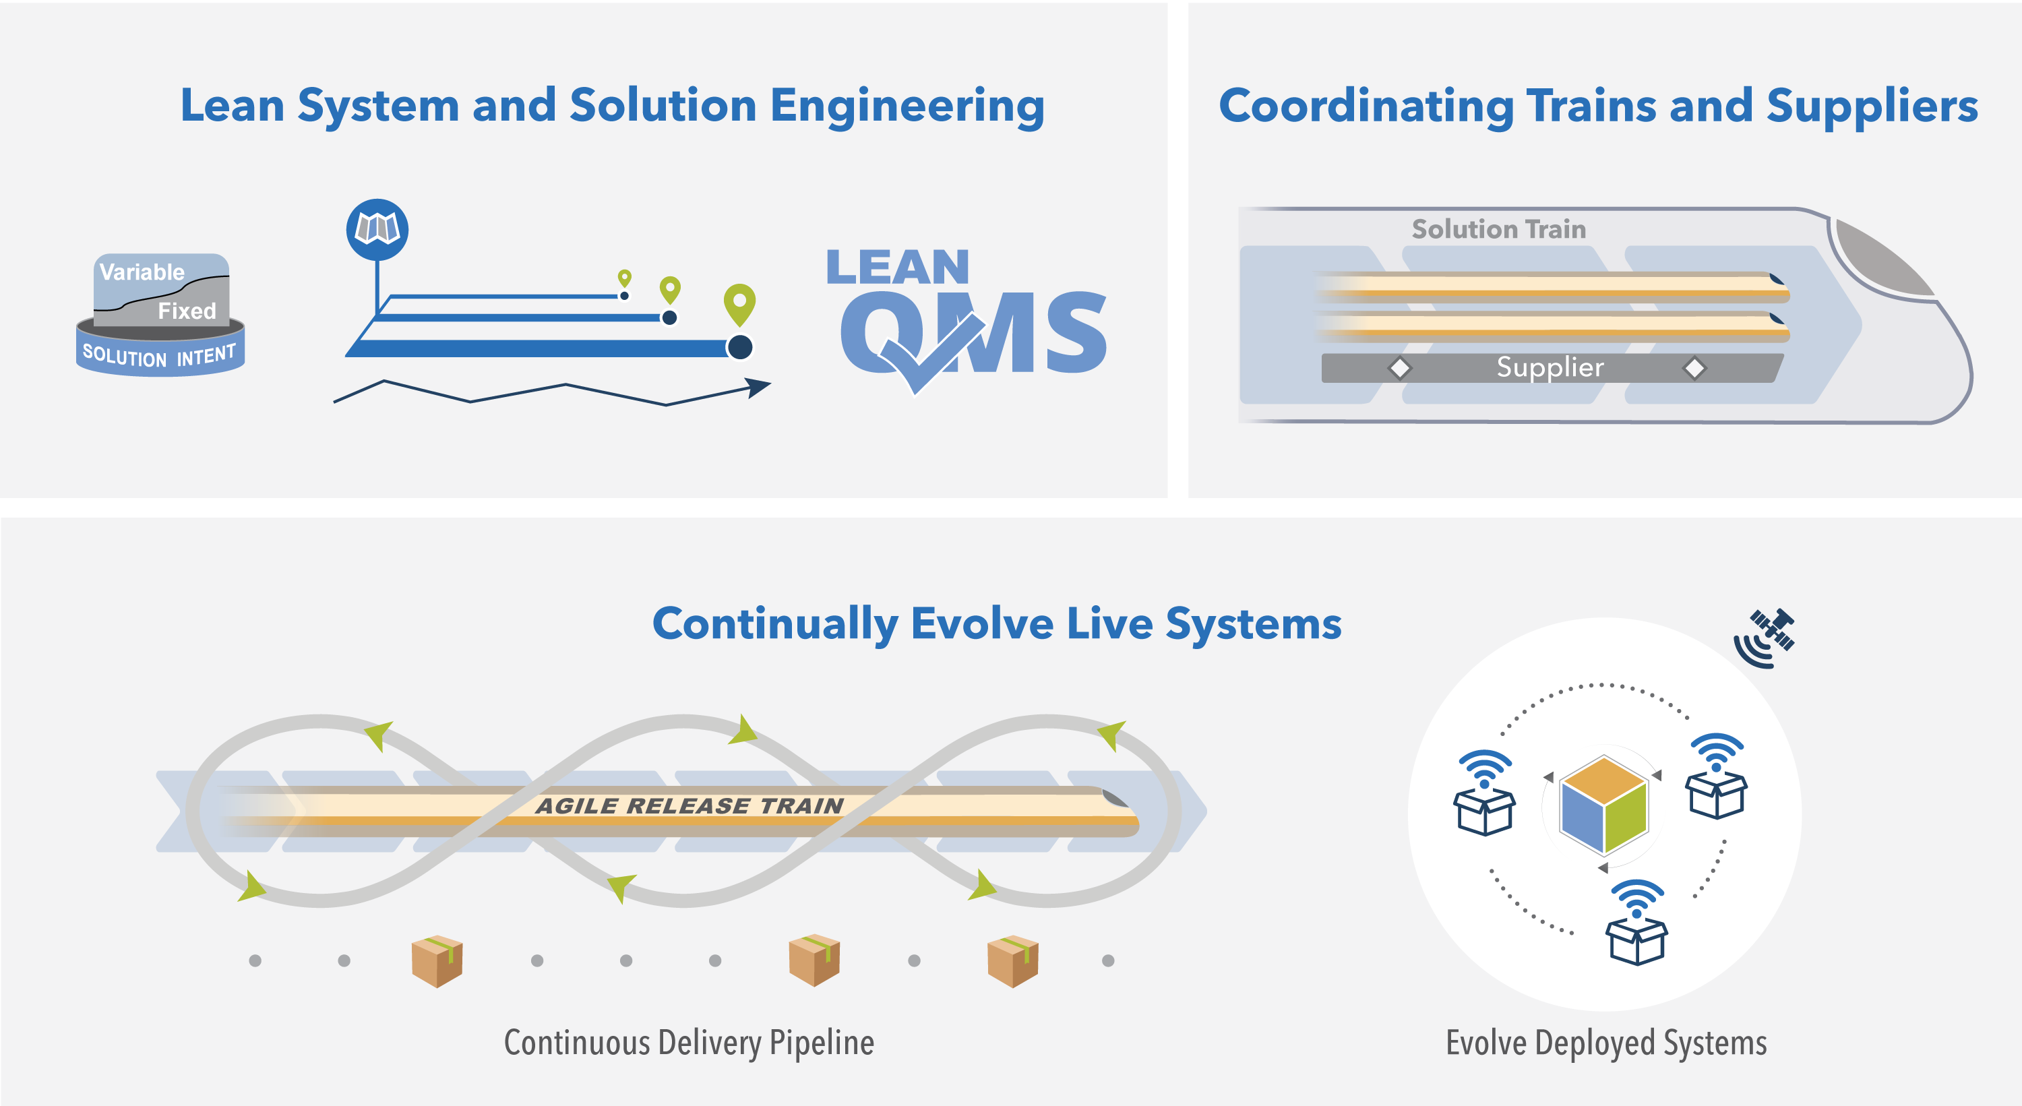
Enterprise Solution Delivery
The Enterprise Solution Delivery competency describes how to apply Lean-Agile principles and practices to the specification, development, deployment, operation, and evolution of the world’s largest and most sophisticated software applications, networks, and cyber-physical systems.
32
Notes:
Trainer Guidance:
The Enterprise Solution Delivery competency describes how to apply Lean-Agile principles and practices to the specification, development, deployment, operation, and evolution of the world’s largest and most sophisticated software applications, networks, and cyber-physical systems.
Lean System and Solution Engineering applies Lean-Agile practices to align and coordinate all the activities necessary to specify, architect, design, implement, test, deploy, evolve, and ultimately decommission these systems.
Coordinating Trains and Suppliers coordinates and aligns the extended set of value streams to a shared business and technology mission. It uses the coordinated Vision, Backlogs, and Roadmaps with common Program Increments (PI) and synchronization points.
Continually Evolve Live Systems ensures both the development pipeline and the large systems themselves support continuous delivery of value, both during and after, release into the field.

Slide 33
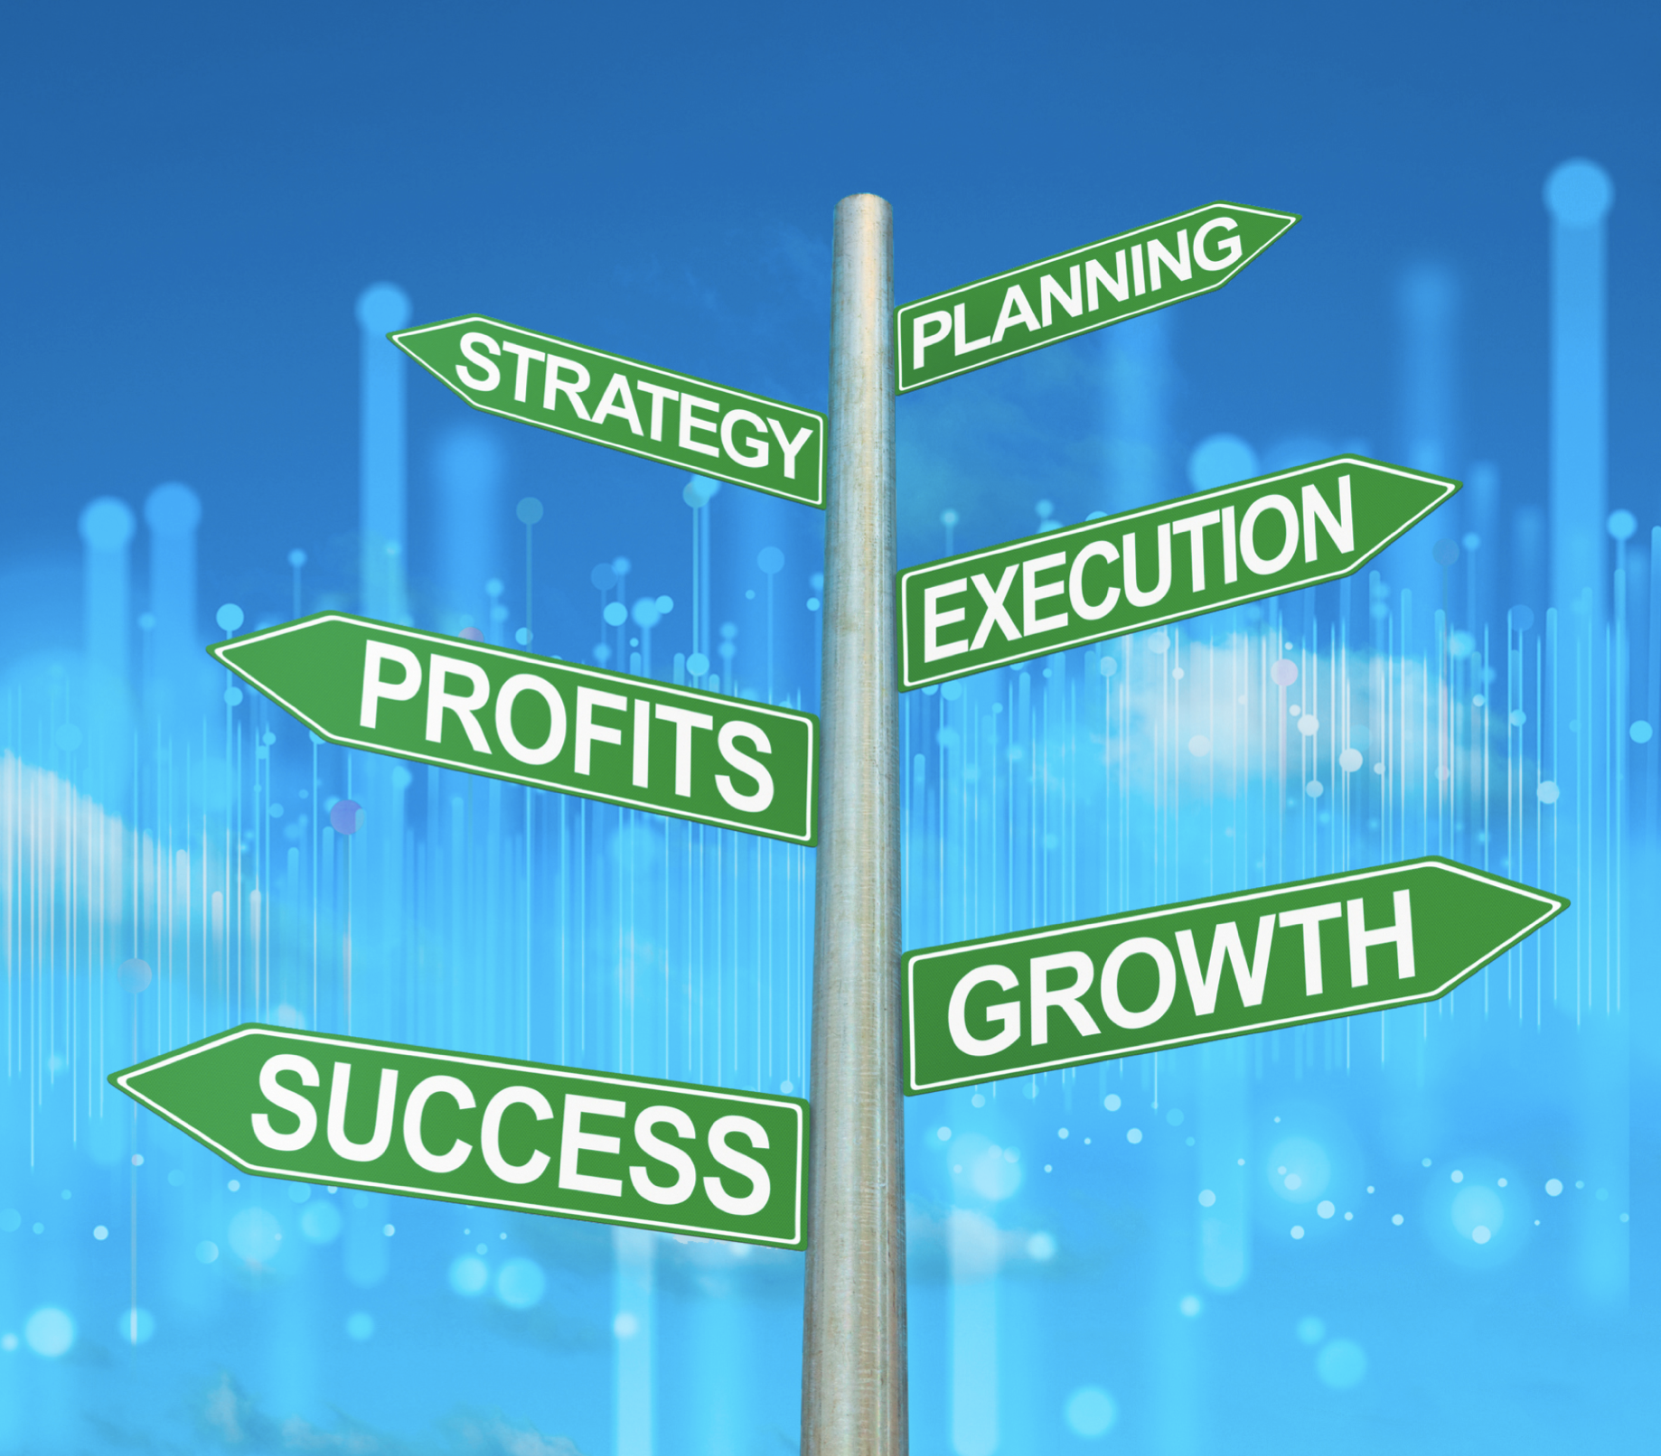
Why Lean Portfolio
Management?
Traditional approaches to portfolio management were not designed for a global economy or the impact of digital disruption. These factors put pressure on enterprises to work under a higher degree of uncertainty and yet deliver innovative Solutions much faster.

Slide 34

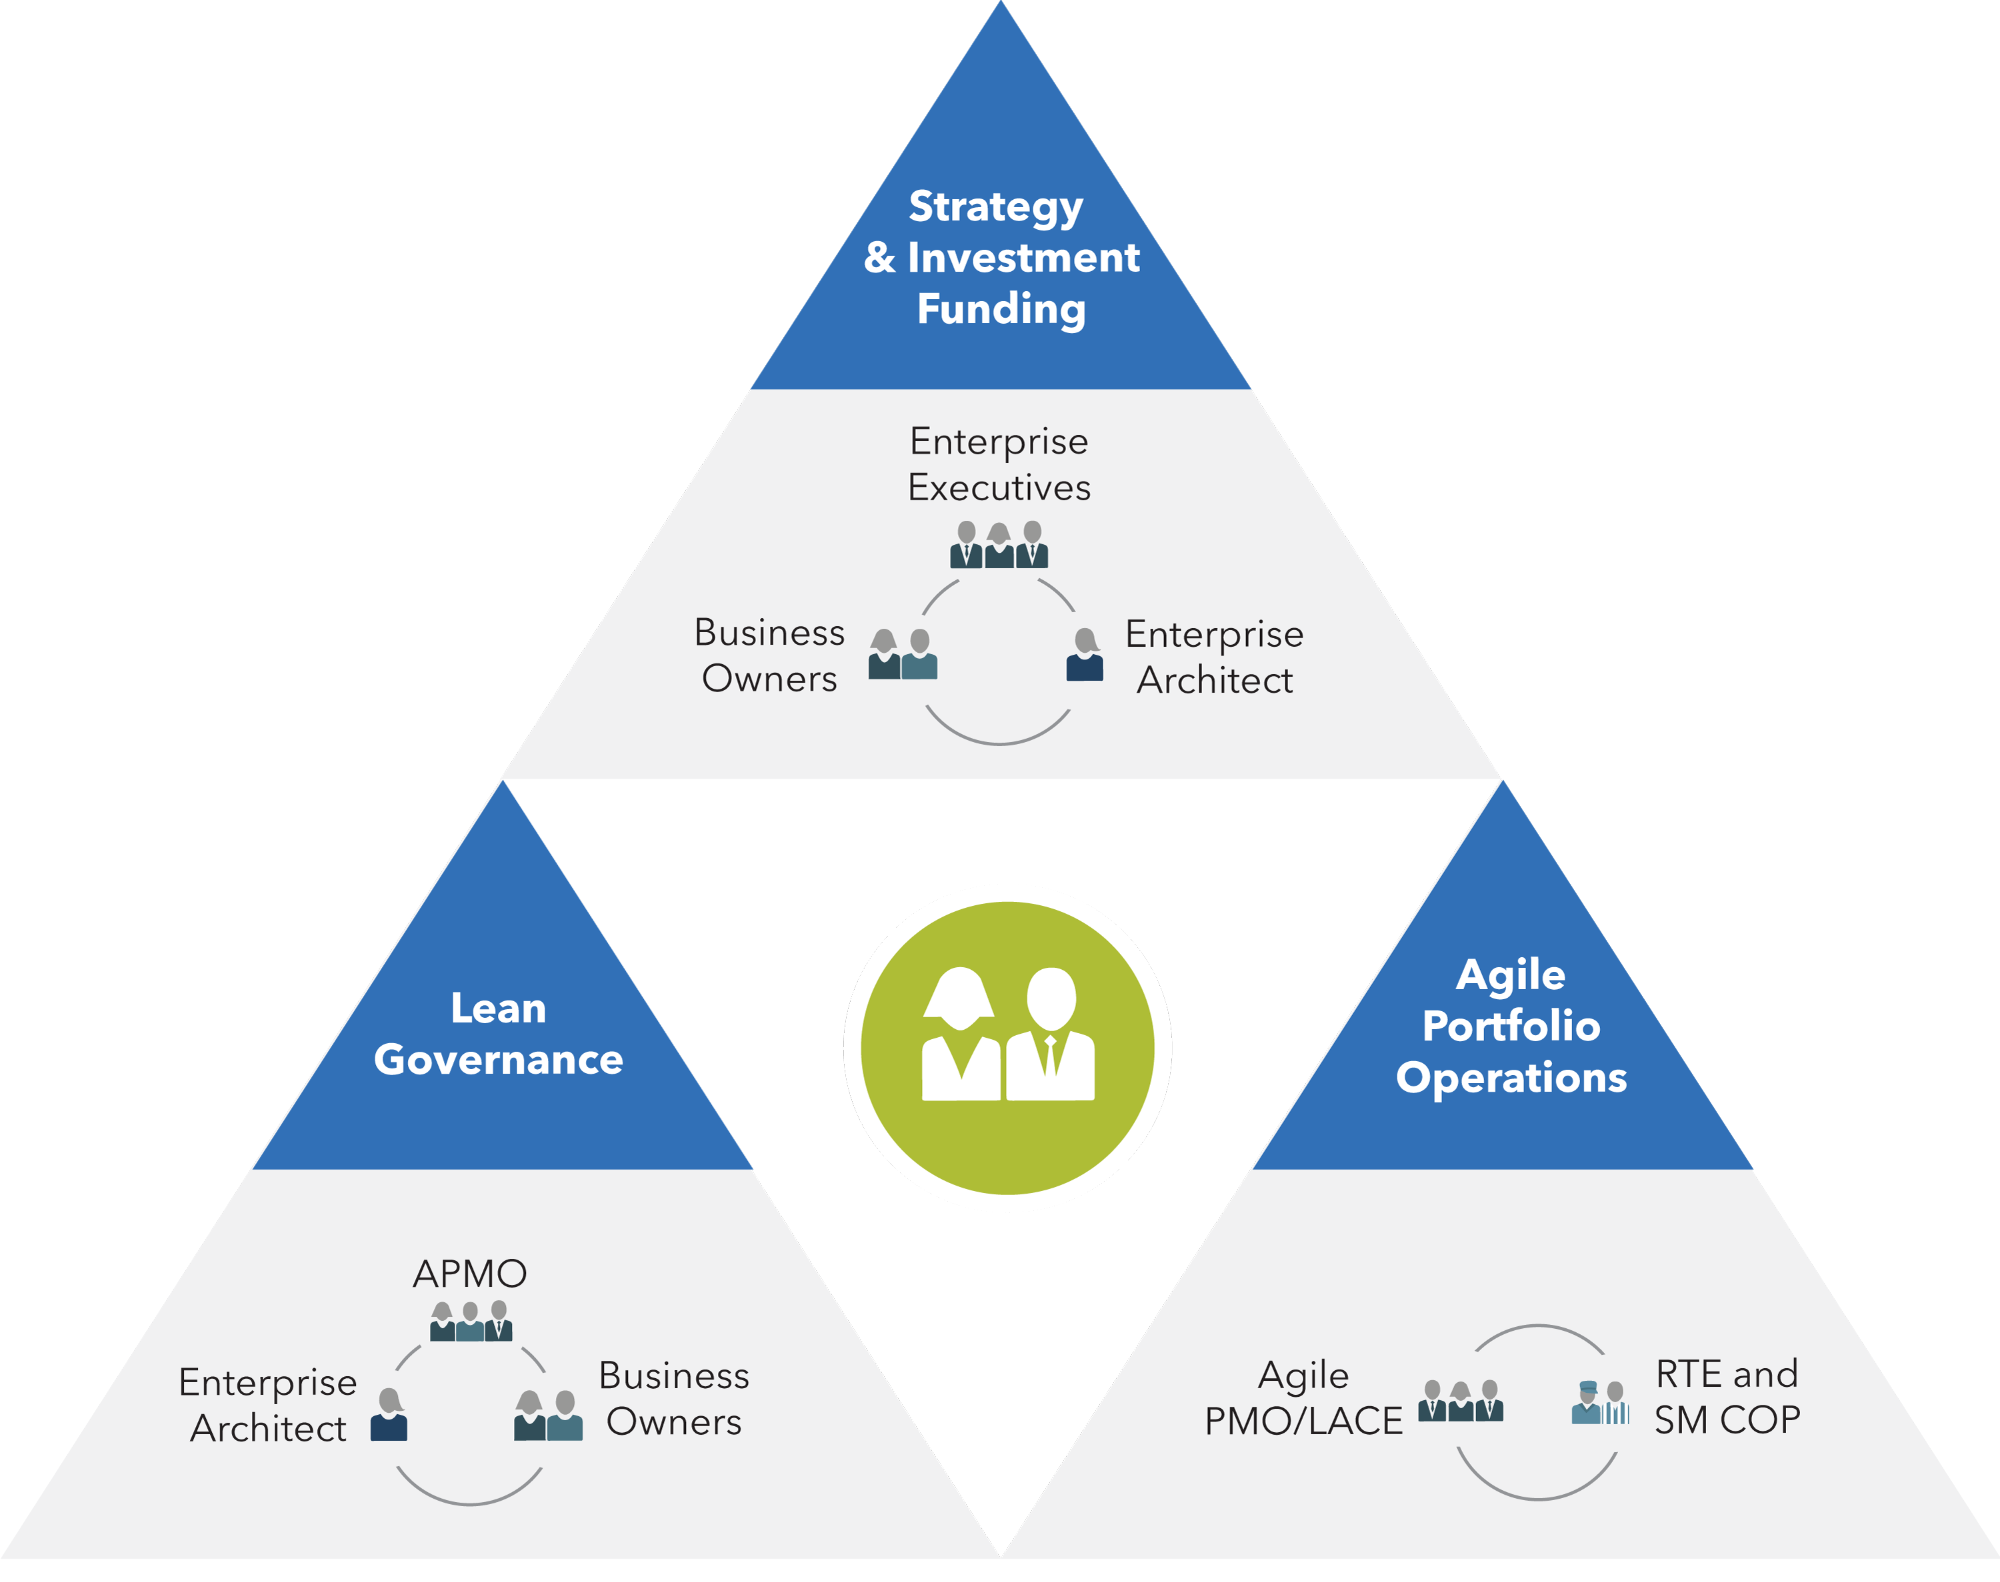
Lean Portfolio Management
The Lean Portfolio Management competency aligns strategy and execution by applying Lean and systems thinking approaches to strategy and investment funding, Agile portfolio operations, and governance.
34
Notes:
Trainer Guidance:
The Lean Portfolio Management competency aligns strategy and execution by applying Lean and systems thinking approaches to strategy and investment funding, Agile portfolio operations, and governance.
Strategy and Investment Funding ensures that the entire portfolio is aligned and funded to create and maintain the solutions needed to meet business targets. It requires the cooperation of Business Owners, portfolio stakeholders, technologists, and Enterprise Architects.
Agile Portfolio Operations coordinates and supports decentralized program execution, enabling operational excellence. It requires the cooperation of the Agile Program Management Office/Lean-Agile Center of Excellence (APMO/LACE) and Communities of Practice (CoPs) for Release Train Engineers (RTEs) and Scrum Masters.
Lean Governance manages spending, audit and compliance, forecasting expenses, and measurement. It requires the engagement of the Agile PMO/LACE, Business Owners, and Enterprise Architects.

Slide 35

Why Organizational
Agility?
Without organizational agility, enterprises simply cannot respond sufficiently to the challenges and opportunities that today’s rapidly changing markets present. Without it, employees and the enterprise associate an individual’s value with their functional skills, rather than business outcomes.
35

Slide 36
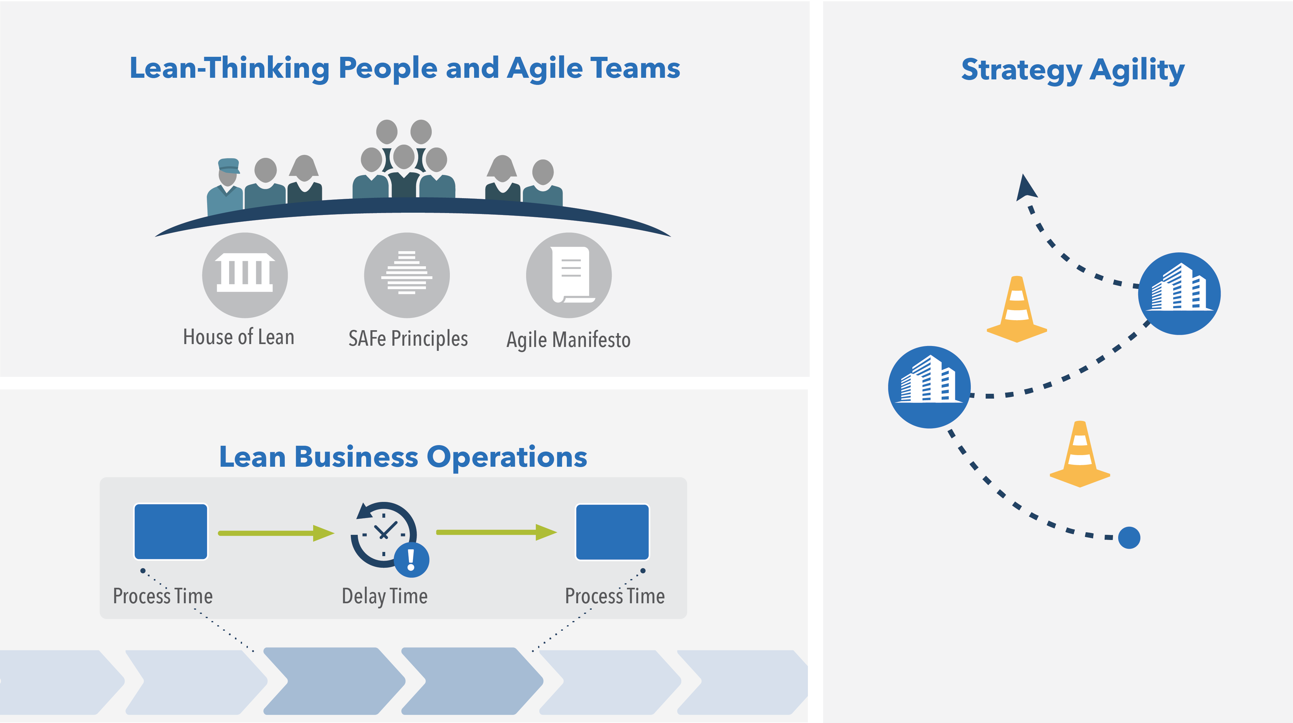
Organizational Agility
The Organizational Agility competency describes how Lean-thinking people and Agile teams optimize their business processes, evolve strategy with clear and decisive new commitments, and quickly adapt the organization as needed to capitalize on new opportunities.
36
Notes:
Trainer Guidance:
The Organizational Agility competency describes how Lean-thinking people and Agile teams optimize their business processes, evolve strategy with clear and decisive new commitments, and quickly adapt the organization as needed to capitalize on new opportunities.
Lean-Thinking People and Agile Teams – This state occurs when everyone involved in solution delivery is trained in Lean and Agile methods and embraces and embodies the values, principles, and practices.
Lean Business Operations – Teams apply Lean principles to understand, map, and continuously improve the business processes that support the business’s products and services.
Strategy Agility – This state occurs when the enterprise shows the ability and adaptability needed to sense the market and quickly change strategy when necessary continuously.

Slide 37
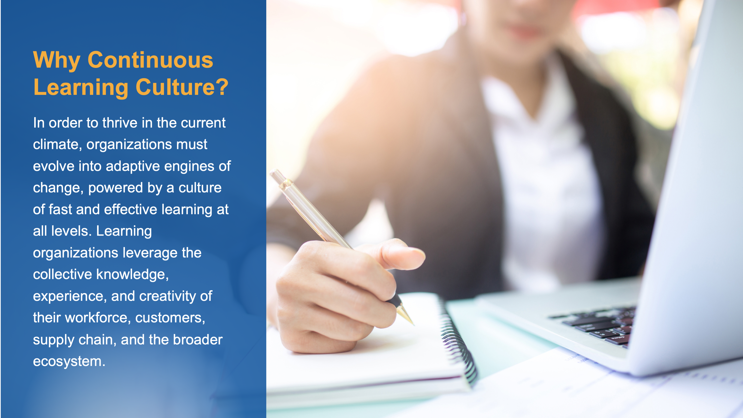
Why Continuous Learning Culture?
In order to thrive in the current climate, organizations must evolve into adaptive engines of change, powered by a culture of fast and effective learning at all levels. Learning organizations leverage the collective knowledge, experience, and creativity of their workforce, customers, supply chain, and the broader ecosystem.
Notes:
Trainer Guidance:
Organizations today face an onslaught of forces that create both uncertainty and opportunity. The pace of technology innovation is beyond exponential. Startup companies challenge the status quo by transforming, disrupting, and in some cases eliminating entire markets. Juggernaut companies like Amazon and Google are entering entirely new markets such as banking and healthcare. At any moment, political, economic, and environmental turmoil threaten to change the rules. Expectations from new generations of workers, customers, and society as a whole challenges companies to think and act beyond balance sheets and quarterly earnings reports. Due to all of these factors and more, one thing is certain: organizations in the digital age must be able to adapt rapidly and continuously or face decline—and ultimately extinction.
What’s the solution? In order to thrive in the current climate, organizations must evolve into adaptive engines of change, powered by a culture of fast and effective learning at all levels.

Slide 38

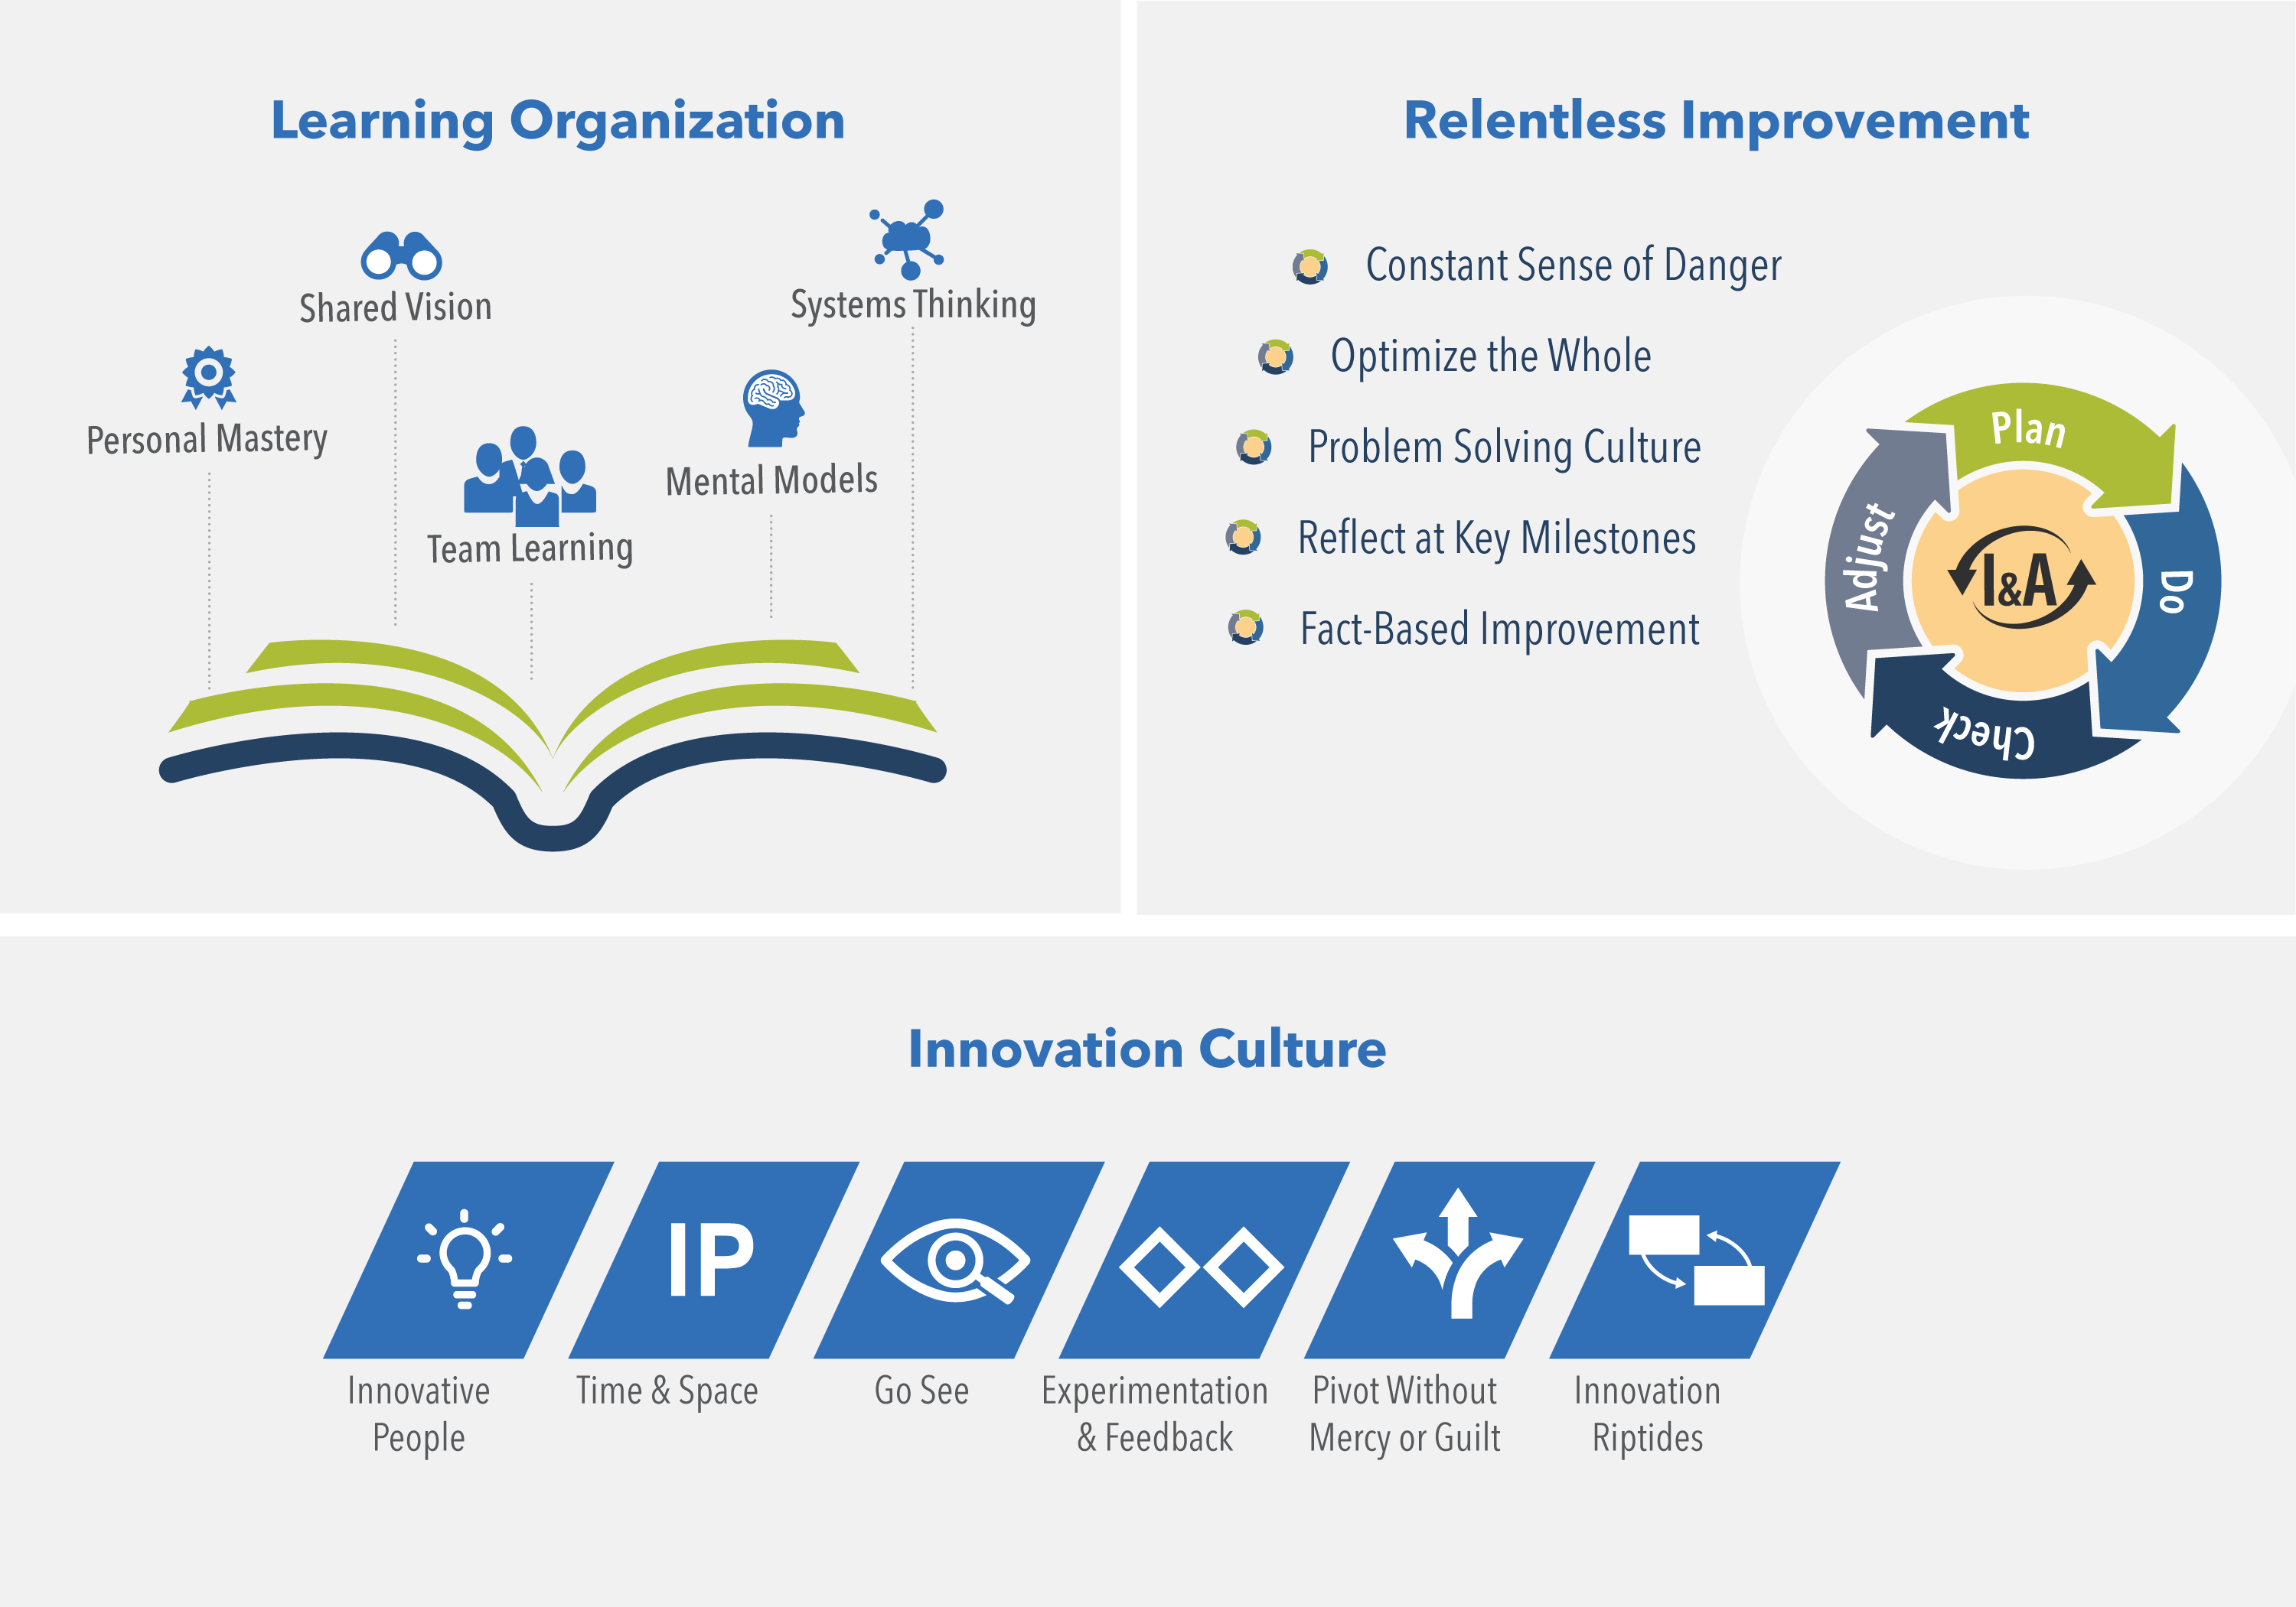
Continuous Learning Culture
The Continuous Learning Culture competency describes a set of values and practices that encourage individuals—and the enterprise as a whole—to continually increase knowledge, competence, performance, and innovation.
38
Notes:
Trainer Guidance:
The Continuous Learning Culture competency describes a set of values and practices that encourage individuals—and the enterprise as a whole—to continually increase knowledge, competence, performance, and innovation. This is achieved by becoming a learning organization, committing to relentless improvement, and promoting a culture of innovation.
Learning Organization – Employees at every level are learning and growing so that the organization can transform and adapt to an ever-changing world.
Innovation Culture – Employees are encouraged and empowered to explore and implement creative ideas that enable future value delivery.
Relentless Improvement – Every part of the enterprise focuses on continuously improving its solutions, products, and processes.

Slide 39
Take the Next Steps
39

Slide 40
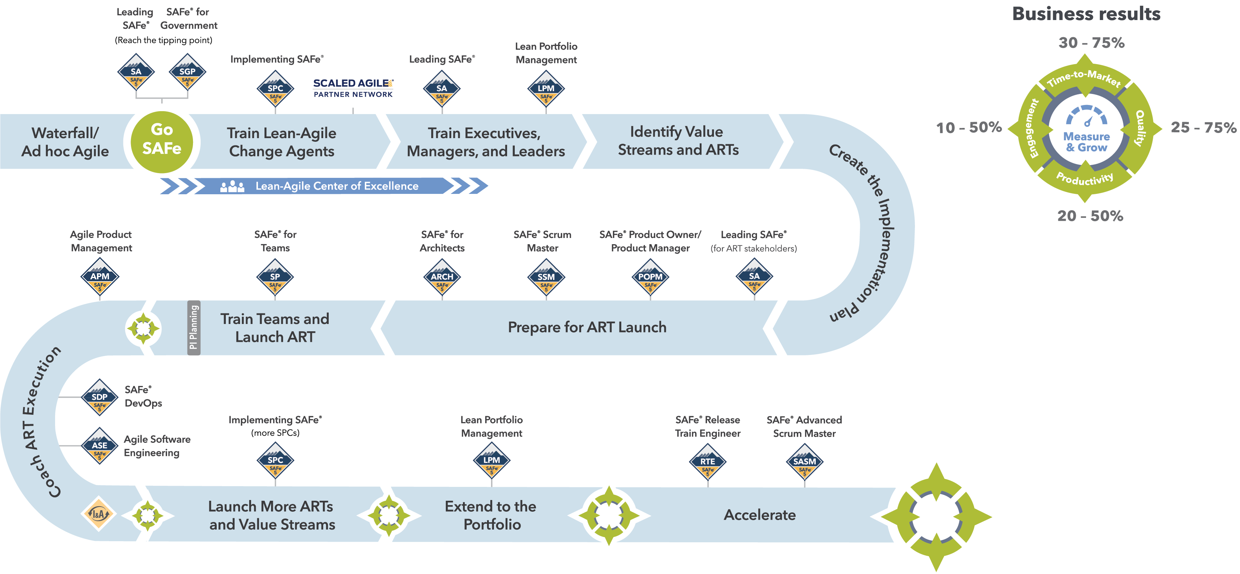
SAFe® Implementation Roadmap
Notes:
Trainer Guidance:
Achieving business agility and the benefits of Lean-Agile development at scale is not a trivial effort, so SAFe is not a trivial framework. Before realizing SAFe’s rewards, organizations must embrace a Lean-Agile Mindset as well as understand and apply Lean-Agile principles. They must identify Value Streams and Agile Release Trains (ARTs), implement a Lean-Agile portfolio, build quality in, and establish the mechanisms for continuous value delivery and DevOps. And, of course, the culture must evolve as well.
Based on proven organizational change management strategies, the SAFe Implementation Roadmap graphic and article series describes the steps or “critical moves” an enterprise can take to implement SAFe in an orderly, reliable, and successful fashion.

Slide 41
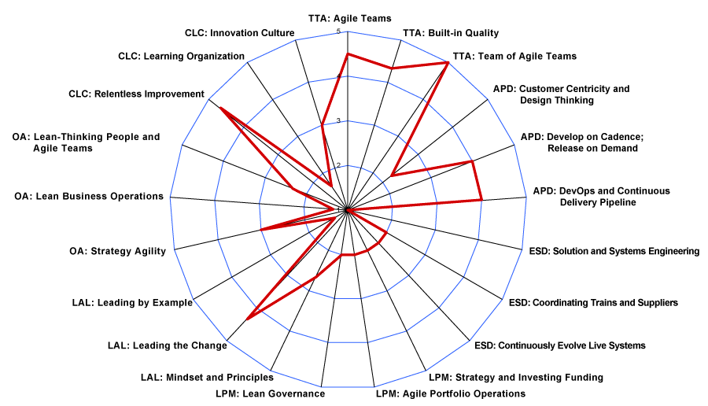
Measure and Grow toward Busines Agility
Measure and Grow is the way each portfolio evaluates their progress toward Business Agility and determines their next improvement steps:
Create a high-level summary using the Business Agility assessment
Go deeper with the Seven Core Competency assessments
Analyze results and identify opportunities to improve
Business Agility Assessment
Notes:
Trainer Guidance:
The SAFe business agility assessment provided on the SAFe website helps enterprises understand where they are on their journey, identify next steps, and remember to celebrate successes along the way. Periodically applying the assessment, contemplating the results, and following the recommendations will help ensure the best possible business outcomes.
Download the SAFe Business Agility Self-Assessment from the Measure & Grow article at scaledagileframework.com.

Slide 42
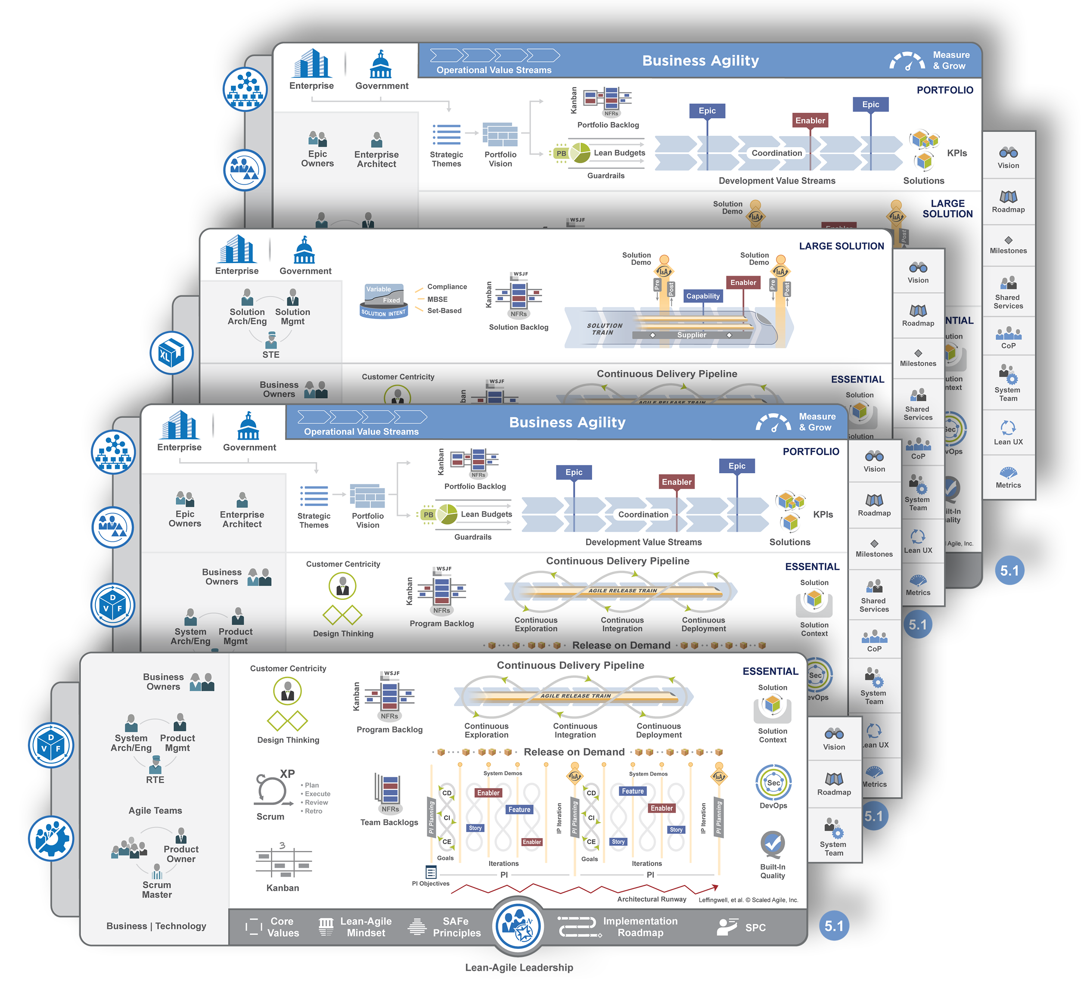
Configure SAFe to meet your needs
Full Configuration
Large Solution Configuration
Portfolio Configuration
Essential Configuration
42
Notes:
SAFe supports the full range of development environments with four out-of-the-box configurations.
The Essential SAFe configuration is the basic building block for all SAFe configurations and is the simplest starting point for implementation. It provides the Lean-Agile leadership competency, the team and technical Agility competency, and the Agile product delivery competency.
The Large Solution SAFe configuration introduces the enterprise solution delivery competency, which supports those building the largest and most complex solutions that require multiple Agile release trains and suppliers, but do not require portfolio-level considerations.
The Portfolio SAFe configuration provides the lean portfolio management competency, which aligns portfolio execution to enterprise strategy. It organizes development around the flow of value through one or more value streams.
The Full SAFe configuration includes all seven core competencies of the Lean enterprise. It is the most comprehensive version of the Framework and supports enterprises that build and maintain a portfolio of large and complex solutions.

Slide 43
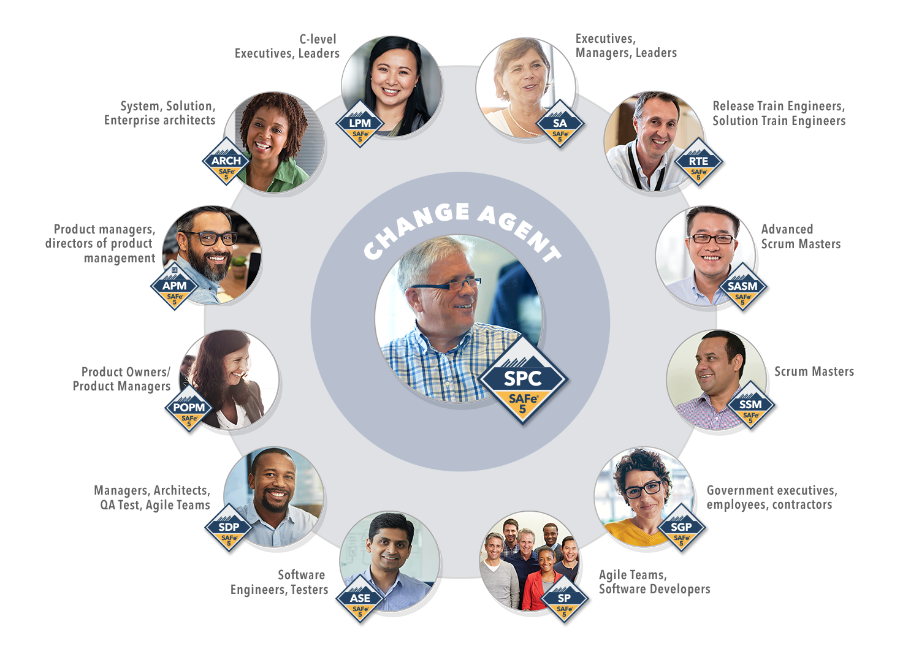
Produce consistent
results across the enterprise with Scaled Agile’s role-based curriculum
scaledagile.com/learning
43
Notes:
Scaled Agile’s role-based curriculum helps enterprises unlock business results with SAFe.
Each course is designed to help individuals maximize the value of their role within a SAFe organization, and help them advance throughout their career as they practice, consult, or train others in SAFe.
The result is higher-quality implementations, and greater stability for the organization.

Slide 44





Connect with the
global SAFe Community
SAFe Community Platform
Access the content, tools, and resources you need to continue learning and practicing SAFe every day.
SAFe Meetups
Find a SAFe Meetup near you at scaledagile.com/calendar and select SAFe Meetup from the Event Type dropdown menu.
SAFe Summits
Attend the world’s largest gathering of SAFe professionals at the Global and Regional SAFe Summit events. Details at safesummit.com.
700,000⁺
trained in SAFe
in over 110 countries

Slide 45
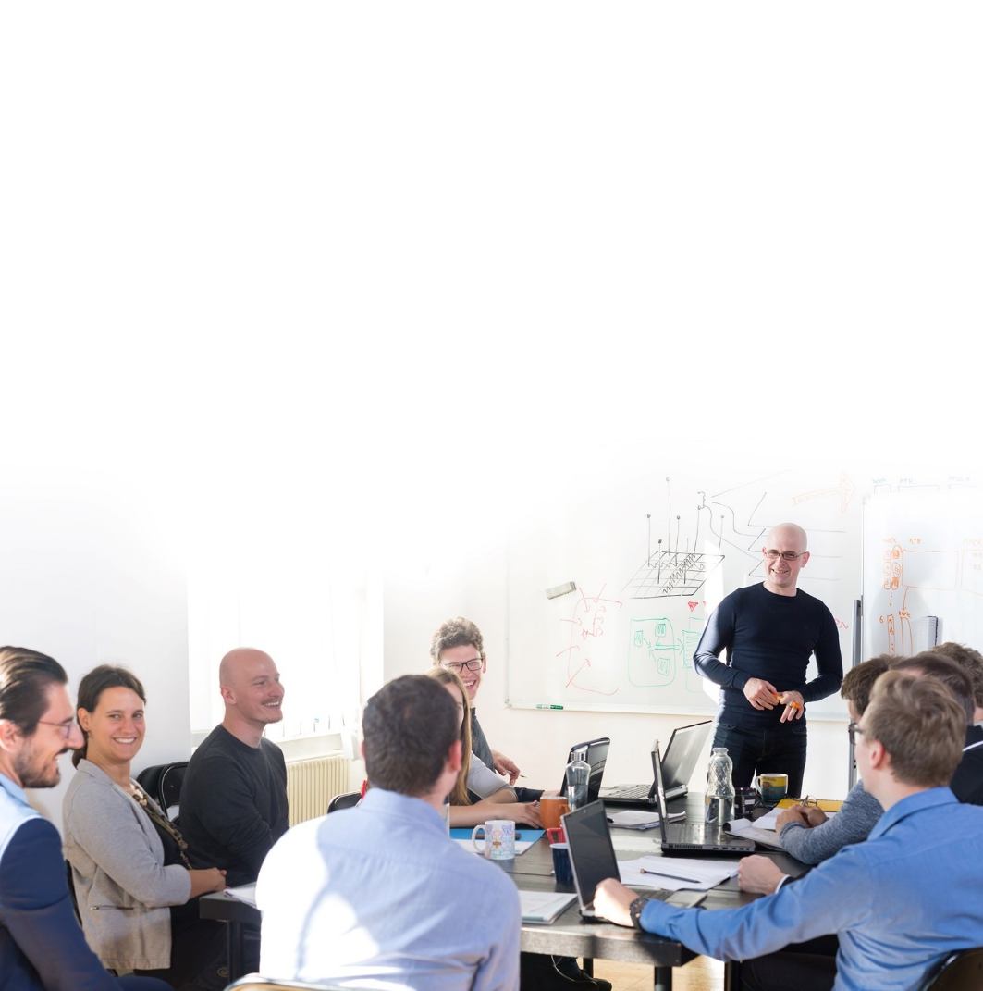
Work with a Partner
to ensure success
Training and coaching for all SAFe roles
Implementation and consulting services across industries and disciplines
Platforms for SAFe automation, visibility, and flow
400
Global Partners
in over 50 countries & 350 cities
scaledagile.com/find-a-partner
45

Slide 46

Questions
46

